Slide 1
Youth is the agent of change
AUB, Essam Fares amphitheater
Rotaract Global MUN, Beirut – Lebanon August 17, 2017.
Dr. Michel P. Jazzar
RI Representative to UN-ESCWA
D.2452 Governor Elect 2018-2019

Slide 2
May I thank Rotaractors Maxton Scotland, Natalia Hermida and of Rotaractors of Sahel Metn to give me, as former PP of Rotaract1976-1977, and, RI 2452 District Governor Elect for 2018-2019, this opportunity to share with you a hearty message based on my experience embracing youth, peace and UN-SDGs

Slide 3
It is with great pleasure that I have received an invitation as RI Representative to the United Nations – ESCWA to address you during the 5th edition of Rotaract Global Model of UN under the main theme of “A Nuclear free world” connecting to the UN Sustainable Development Goals.

Slide 4
Since its establishment, Rotary has worked closely and in partnership with the United Nations and other organizations toward a better and more peaceful world.

Slide 5
Rotary currently holds the highest consultative status offered to a nongovernmental organization by the UN’s Economic and Social Council-ECOSOC, which oversees many specialized UN agencies.
Rotary maintains its relationship with a number of UN bodies, programs, and commissions [e.g. ESCWA] through its representatives.
Serving as Rotary’s informal “ambassadors” the representatives work toward strengthening Rotary’s participation and reputation at the United Nations and the international community.

Slide 6
One of my specific objectives, as RI Representative to UN-ESCWA, since 2006, is to identify programs, projects or activities where Rotary clubs might coordinate their efforts with the ESCWA at national or district levels.

Slide 7
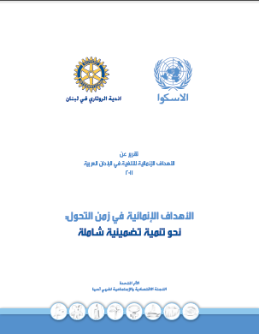
The common effort between ESCWA and Rotary clubs of Lebanon brings back a book “MDGs during Transition: Towards an Inclusive and Comprehensive Development“ in a special version.
This new issue of ESCWA's MDG Report edited late 2011, renewed year 2013 and updated with the new indicators of the 17 SDGs was printed out into 3000 items

Slide 8
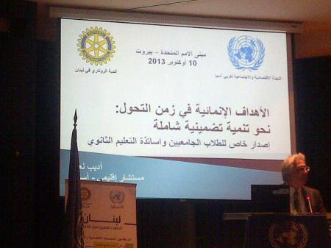
and addressed for the university students at the Institute of Social Sciences (Lebanese University) adopted as part of their curriculum, and to the teachers of Social Sciences and Economics at public secondary schools (in coordination with Ministry of Higher Education).

Slide 9
I would have loved to keep going to tell you a story from the past, but I think it is the future that interests us. While the past is attached to the history of self, leadership is projected into the future.

Slide 10
That is why I adapt my address to be consistent with our vision as 2018-2019 Governor of D.2452 which brings together nine countries (across 3 continents and 5 different languages).

Slide 11
Because you are the future, “Nuclear Free world” keeps you highly concerned and a civic education within Rotary values could draw a path map for a world free of nuclear.

Slide 12
So these are two strong directions of the Rotary coming year and I invite you to be part with conviction, confidence and passion:
1-“Youth is our Future” being the District 2452 theme for 2018-19
2-“Civic education and Peacebuilding” being the customize District 2452 area of focus.

Slide 13
1- RI District 2452 theme 2018-2019: “Youth is our Future.”

Slide 14
We presently have the largest population of young people that the world has never known.

Slide 15
The UN GS said:
“The NGOs must reach across ALL generations to create transformational and change.”

Slide 16
I am strongly convinced that the YOUTH is our “agent of change”. Using “is” instead of “are” in the District theme “Youth is our Future”, because we believe that youth is not only a matter of age, but of spirit as well.

Slide 17
Rotarians and Rotaractors, with their spirit of volunteering, the passion into engagement, the same grit in front of negativity, have many in common.

Slide 18
Rather than letting young people work in isolation, intergenerational joint projects are evidence of mutual trust to serve society together and give young people the opportunity to shape the future.
This initiative is to be accompanied by dialogue and to promoting the intergenerational exchange to reach together the unreachable!

Slide 19
Through partnerships with Rotary Clubs, community groups and leaders, YOUTH can demonstrate the benefits of their actions, into any field: Education, health, peace, environment …

Slide 20
Such communication, planning, acting, monitoring and evaluating channels enable young people and Rotarians to explore common problems they face and to tackle them together, thus participating in the emergence of sustainable solutions and demonstrate that “Youth is our Future”.

Slide 21
By valuing the end of the action we will tie people within different groups, we will reduce the gap between generations and we push for an intergenerational dynamic of “osmosis and diffusion.”

Slide 22
To succeed, the District theme 2018-19 implementation needs your support, involvement and engagement in the program that it will be set by Rotarians former Rotaractors and current Rotaractor clubs members.
The highlights of this program will be discussed during brainstorming retreat and meetings with you, so we will be fine for its implementation starting 1st of July 2018.

Slide 23
2- Civic Education and Peacebuilding.

Slide 24
Surrounded by violence, civil wars, fear, Lebanon and many other countries of District 2452 are crushed under the weight of, refugees flooding from Iraq, Syria, Palestine and in addition to already existing infrastructure, environmental, economic and social issues!

Slide 25
This apocalyptic panorama has different roots.
One of them is the lack of belonging to humanity and the movement of peoples enlightened by positive peace, that social peace which is at the basis of world peace.

Slide 26
Our project is to train educators, in pilot governmental or private schools, by Rotary trainers with a specific curriculum and adapted materials, through cooperative games, participatory and creative conflict resolution activities which stress upon peaceful existence, civic engagement and awareness about larger issues, and thus to highlight the Rotary core of values which are: Diversity, leadership, friendship, integrity and service.

Slide 27
Knowledge of civic rights and development of the skills and practice of peaceful social engagement form the core of civic education. Effective programming in civic education requires special focus on classroom techniques; modeling good civic behavior in the classroom is necessary to impart civic skills for participation, in addition to knowledge of rights and processes.

Slide 28
Case studies of civic education programming in District countries illustrate the challenges of working in post conflict contexts and prevent new conflicts. These challenges can be met partially by a focus on high-quality materials and teacher training, engagement with education officials at the highest level possible, and sustained attention and adaptation following lessons learned.

Slide 29
The cases also show that opportunities arise continually to use civic education more informally, as in periods of constitutional reform or elections, when attention fixes on issues of governance and participation. Using creative techniques, such as music or theater, can carry the message to a wider audience, often more effectively, than printed materials.

Slide 30
Together, the theory and practice of civic education stimulates attention to the importance of civic knowledge, skills, and practice in designing peacebuilding support for post conflict societies or to prevent new conflicts.

Slide 31
Civic competency includes not only civic knowledge, but also civic skills and interpersonal/intrapersonal dispositions.

Slide 32
In the areas of peacebuilding within community, we have witnessed the need for civic education.

Slide 33
The RI District 2452, through high level educated Rotarians will start brainstorming and managing inter-relationships between Rotary, young generation and UN agencies that can be interested in the project to set its strategy and curriculum content before the 1st July 2018.

Slide 34
To wrap up the “civic education and peacebuilding” , I believe that the limitations of particular resources has never been hindered the philosophy of civic education and engagement and we have witnessed cooperation in the local and the international scales from offering a way to actively tackle in order to promote good behaviors.

Slide 35
Cooperation among Rotary family and friends of Rotary has often reached a valuable end.
It is your role, young people, to tangle hands , to work together on challenging the systems in place with a philosophy of inclusiveness and a vision of tomorrow leaders – a matter, in my humble opinion - that the world is in dire need of.

Slide 36
Rotary brings together a global network of volunteers dedicated to tackling the world’s humanitarian challenges.

Slide 37
Rotary, within societies and young leaders, builds peace, international understanding through education and humanitarian service.

Slide 38
You are those young leaders and we believe in your capacity to change the world for a better place to live.
YOU ARE THE AGENT OF CHANGE.

Slide 39
“If you ever think you’re too small to be effective, you’ve never been in bed with a mosquito!”
— Wendy Lesko

Slide 40
Thank you!

