Slide 1
Rotary and the United Nations RI’s Representative Network

Slide 2
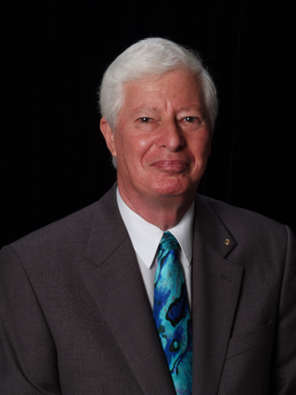
Rotary and the United Nations: RI’s Representative Network
Peter Kyle will serve as Primary Representative to the World Bank beginning 1 July.
Peter is a lawyer and was employed by the World Bank in a senior legal capacity from 1992 to 2009.
DG for District 7620
(Washington, DC and Central Maryland)
Member of the Rotary Club of Capitol Hill, Washington, DC, USA
Notes:
Peter to introduce himself to the audience

Slide 3
Rotary and the United Nations: RI’s Representative Network
Today’s Panelists:
Peter R. Kyle ⏐World Bank (Washington, DC)
Knut J. Johnsen ⏐United Nations (New York)
Ayoub M. Ayoub ⏐Arab League (Cairo)
Notes:
Peter to introduce today’s panel

Slide 4
Rotary and the United Nations: RI’s Representative Network
Notes:
Peter welcomes everyone in the audience to the session. Introduces the Rep program and why its important for Rotarians to know about them.
Rotary’s proven track record - polio eradication, water and sanitation – have placed Rotary in a position of increasing respect and prestige in the international community.
Rotary needs to mature its internationality through its ongoing relationships. We’re at a point where we can approach these organizations – and have much to offer.
In keeping with its international maturation, Rotary will increasingly help to set the global agenda and be a key player as an organization that gets things done.

Slide 5
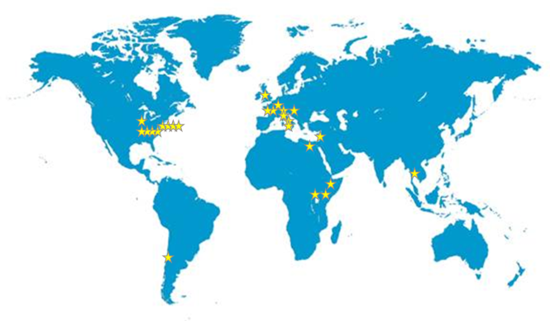
The Rotary Representative Network
Notes:
Rotary’s Representatives are assigned to 15 international organizations in 14 cities around the world.
These organizations include:
United Nations Headquarters in New York as well as offices in Geneva and Vienna
United Nations Regional Commissions:
UN Economic Commission for Europe (ECE)
UN Economic Commission for Africa (ECA)
UN Economic Commission for Latin America and the Caribbean (ECLAC)
UN Economic and Social Commission for Western Asia (ESCWA)
UN Economic and Social Commission for Asia and the Pacific (ESCAP)
United Nations Educational, Scientific and Cultural Organization (UNESCO)
UN Environment Programme (UNEP)
UN Habitat
Food and Agriculture Organization (FAO)
World Food Programme (WFP)
International Fund for Agricultural Development (IFAD)
Council of Europe
European Union (EU)
African Union (AU)
Organization of American States (OAS)
League of Arab States
Commonwealth of Nations
Organization for Economic Cooperation and Development (OECD)
World Bank

Slide 6
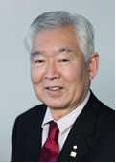
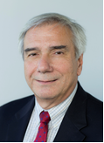
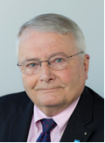
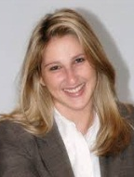
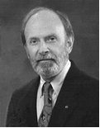
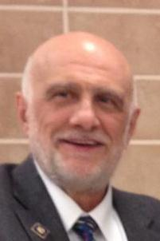
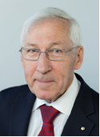
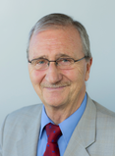
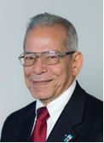
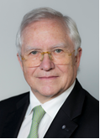
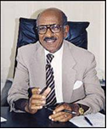
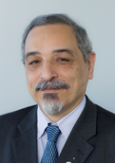
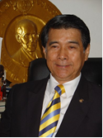
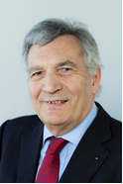
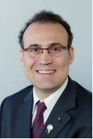
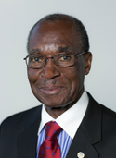
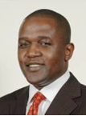
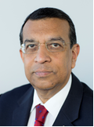
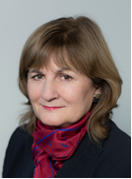
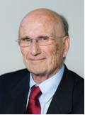
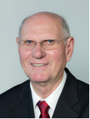
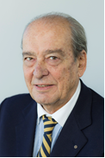
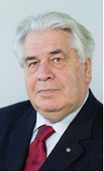
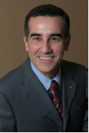
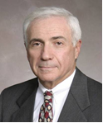
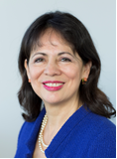
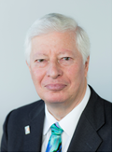
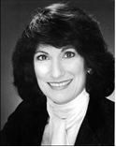
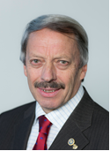
2014-15 Rotary Representatives
Dean
UN: New York
UN: Geneva
Arab League
Ed Futa
Joseph Laureni
Helen Reisler
Knut Johnsen
Susanne Gellert
H. Bradley Jenkins
Joseph Dino
Resham Parikh
Ioana Zamfir
Peter Eichenberger
Francis Godel
Ayoub Ayoub
UN: Vienna
UN: Regional Commissions
UNESCO
UNEP
UN-HABITAT
Commonwealth
Anton Hilscher
Nahu Araya
Michel Jazzar
Somphop Sooksing
Serge Gouteyron
Cyril Noirtin
Henry Kyemba
Joe Otin
Kaushik
Manek
Judith Diment
Council of Europe
FAO, WFP, IFAD
OAS
World Bank
At Large: DC
EU
Gérard Caen
François Goettelmann
Marco Randone
Antonio Lico
Alberto Cecchini
Richard Carson
Clara Montanez
Peter Kyle
Doris Margolis
Michel Coomans
Notes:
32 Rotarians will serve as Representatives during the 2014-15 Rotary year.
2013-14 saw the creation of the position of Dean of the Representative Network, now held by Ed Futa.
Additionally, for the first time, two Rotaractors, Resham Parikh and Ioana Zamfir, have been appointed to serve as Youth Representatives to the UN in New York.

Slide 7
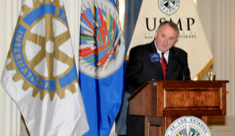
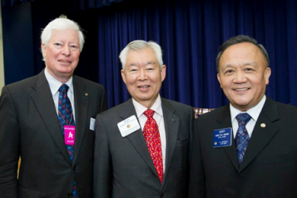
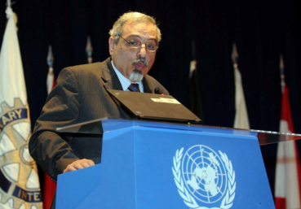
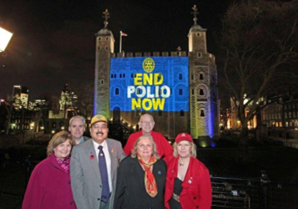
Rotary Representatives: What they do
Rotary Representatives:
Serve as Rotary’s “ambassadors”
Educate international community about Rotary
Organize promotional events
Support Rotary public relations campaigns
Update Rotarians about international activities
Notes:
Selected each year by the RI President, Representatives serve as Rotary’s unofficial “ambassadors” to governments, international institutions and other civil society organizations.
Representatives provide:
“Eyes and Ears” on the ground
Update Rotarians about UN and other national/international initiatives such as the Post 2015 Development Agenda (follow-up to Millennium Development Goals)
Initialize and maintain ongoing contact with key local, national and international influencers.
Coordinate key events such as Rotary Days at the UN, UNESCO, and the White House or President Burton’s Lecture of the America’s presentation at the OAS.
Educate Rotarians about Rotary’s role in the international community at sessions like this.
Assist with Rotary public relations initiatives such as translating PR materials into local languages or supporting End Polio Now lightings and public events

Slide 8
United Nations System
TAKE ACTION, EXCHANGE IDEAS, JOIN LEADERS

Slide 9
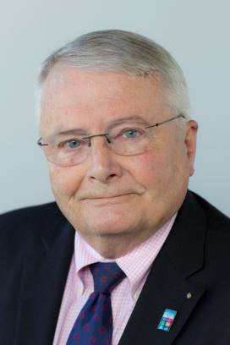
Rotary and the United Nations
Knut J. Johnsen serves as an Alternate Representative to the United Nations/New York
DG for District 7210 (New York) in 2003-04
Member of the Rotary Club of New Windsor-Cornwall, NY, USA
Notes:
First speaker. Knut Johnsen - introduction
I’m here today to tell you about how Rotary and the United Nations share a history of working together toward world understanding and peace.

Slide 10
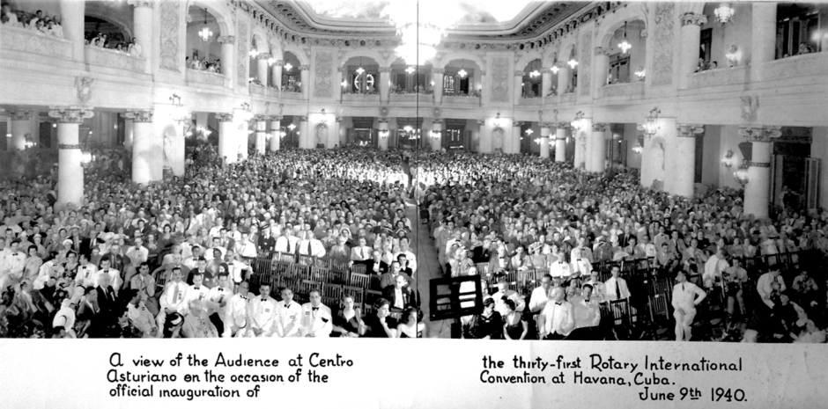
Rotary and the United Nations: History
Notes:
The story of Rotary International’s role in the creation of the UN has been well-told, but it is not well-know at home or abroad, or even among Rotarians.
From our initial “Resolution of Human Rights” at 1940 RI Convention (slide) in Havana to the 1942 gathering of peace planners in London which evolved into UNESCO, to the participation by Rotary as observers at the early preparation meetings in Hot Springs, Virginia; Atlantic City, NJ; Bretton Woods, New Hampshire; Chicago, Illinois; and Dumbarton Oaks, (Washington D.C.), Rotary was an active participant in the creation of the UN. In 1945 there were only a few organizations with a world-wide reach that Rotary has.
At the UN Charter Conference in San Francisco in 1945, many but not all of you would know that Rotary played a prominent role, with our top leadership among the 23 official observers – 11 to the US delegation alone. It was the largest observer group that was accredited. Of the 50 nations present, 27 delegates or technical advisors were Rotarians and 5 were delegation heads. With other non-governmental organizations we influenced the text and focus of the charter, particularly on economic, social and humanitarian issues.” Today we are one of 50 or so leading international non- governmental organizations in “category one” having consultative status with ECOSOC (Economic and Social Council.) There are more than 3,000 NGOs registered with ECOSOC and another 4,000 registered with Department of Public Information.
And we didn’t stop there. For 10 years thereafter we embarked on a program to educate the world about the promise of the UN. We authored books and booklets, published some 100 articles about the UN in the “Rotarian” magazine, and at the club level we held annual “World Affairs Council” meetings to inform Rotarians about the structure, leaders, programs and agencies of the UN.

Slide 11
Rotary and the United Nations: History
Notes:
3 slides - all referring to book
Most of what you hear about the UN in the media is what happens in the Security Council and the General Assembly. This represents about 20% of the work of UN. Our involvement is with social, economic and humanitarian issues which now comprise 80% of the work of the UN and which are also at the heart of Rotary.
At this point I would like to say what the UN is not. It is not a world government, not a legislature to redistribute wealth, not a military force with a commander in chief, and it is not financially secure. It has no sovereignty, nor does it seek it. It is a mobilizer of political will, an organization of sovereign states seeking peace, law and order, and social justice. It is the world’s largest research and statistical organization (a library of 5 million documents) which alone is worth the money. Finally, the Secretary-General is not a CEO, nor commander in chief but an administrative Chief Operating Officer.
Rotary was very active at the beginning but because of the advent of the Cold War it became disenchanted with the UN and produced a hiatus of some 30 years. However, when we started our worldwide PolioPlus program in the mid-1980s, we immediately realized that working in partnership with UNICEF and the World Health Organization was a necessity and we quickly re-established our presence at the UN in New York, then in Geneva, Vienna and at UNESCO (UN Educational, Scientific and Cultural Org) in Paris. This partnership has lasted some 25 years and was renewed 2011 for an additional 5 years. Today we have 26 representatives around the world. They are located in NY, DC, Santiago Chile, Paris, Geneva, Strasbourg, Vienna, Rome, Bangkok, Lebanon, Ethiopia, and Nairobi.
Rotary has a UN office across the street from the UN overlooking the general assembly building. Primarily because of our work with polio Rotary remains one of the most respected non-governmental organizations in the UN System.
There is a description of our job in the OD.
“RI Representatives are assigned to the UN and other organizations to enhance Rotary’s visibility.”
“Representatives monitor their assigned organization(s) and provide information on Rotary’s established policy, programs, and activities.”
We promote the goals and work of Rotary and The Rotary Foundation by networking with the many NGOs and governmental organizations within the UN system, through ongoing public relations efforts targeted at the UN, NGOs and intergovernmental agencies. In all cases we provide information about Rotary activities to the UN and we receive from the UN agencies detailed information, statistics, and project ideas which, we provide to the program staff at the TRF and the external relations department at RI.

Slide 12
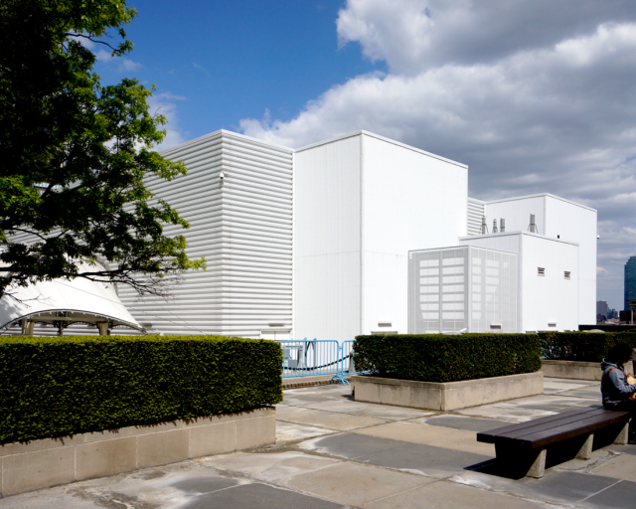
Rotary and the United Nations: Today
Notes:
Temporary building slide
A temporary building was built on the north lawn at UN Headquarters. The Secretary General’s offices and some other key offices were located here. In addition the 14 meeting rooms that were in the conference center have been duplicated here. Rotary UN Day has been held in this building for the past 5 years. This building will likely be dismantled at some point in the near future.

Slide 13
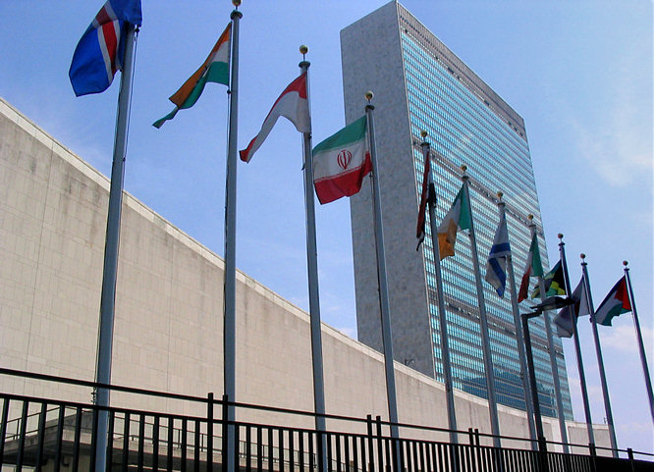
Rotary and the United Nations: Today
Notes:
UN Secretariat :
In the meantime the Secretariat has re-opened and the 3000 employees have moved back in and the Secretary General is now
occupying the 38th floor. The building is spectacular and is state-of-the-art. It will cost 50% less to operate.
Why not tear down the existing buildings and start over? The UN Complex is both historical and an architectural landmark. It is seen
all over the world as a symbol of the United Nations and its rare example of international style architecture of the 1950s. Demolition
would have neither saved time or money.
The hazardous materials would have had to be removed first, the buildings would have to be demolished floor by floor, and every single function would have had
to find a new temporary home elsewhere.
The cost of the project - which is estimated at over $2 billion - is being financed by assessment from the member states.
A word about our representatives in New York:
We have 5 Representatives representing Rotary at the United Nations in New York.
In 2013, The RI Board of Directors approved two more representatives and they will be our youth representatives.
1) Resham Parikh 23 years old and a member of the Rotaract Club at the UN. She is currently working for Edelman
Public Relations Worldwide as an Assistant Account Executive.
2) Ioana Zamfir 21 years old and a native of Romania. She is a student of Yale University and a member of the Rotaract
Club at Yale. Both young women are very well qualified and very enthusiastic about joining our team. Ioana has a family history with
Rotary that gives here a broader perspective into what we are about and what our mission is. There responsibilities will include, attending
youth meetings at the UN, helping to plan and execute the youth session at Rotary UN Day in November and help us establish social
media presence.
A word about UN Day:
- Each year Rotary Day at the UN attracts more than 1,200 Rotarians including many Rotary International Directors, Foundation Trustees,
past Senior Leaders, and guests who come together at United Nations Headquarters in New York.
The program is designed to inspire and educate all participants as well as provide insight into the relationship between Rotary and the United Nations.
This year “Rotary Day at the United Nations” will be held on November 1st and will include remarks by incoming Rotary International President Gary Huang, Incoming Chair of the Trustees John Kenny and General Secretary John Hewko – plus key speakers from the United Nations system.
In addition we will have interactive sessions on such topics as water, literacy, youth, health and much more.
If you are planning a New York vacation this year plan it around UN Day and join us. Be sure and register early as the day sells out quickly.
Thank you.

Slide 14
League of Arab States
TAKE ACTION, EXCHANGE IDEAS, JOIN LEADERS

Slide 15
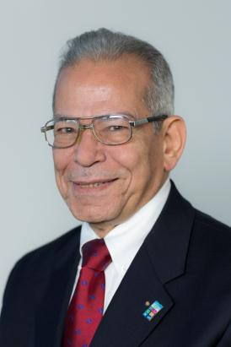
League of Arab States
Ayoub M. Ayoub serves as Rotary Representative to the Arab League
Ayoub also serves as a Rotary Public Image Coordinator
A career diplomat with posts on five continents
Member of the Rotary Club of Heliopolis, Cairo, Egypt
Notes:
Ayoub Ayoub - introduction
As commercial diplomat, Ayoub his postings took him to Switzerland, Syria, Sudan, Somalia, China, Australia and India. He was country representative in League of Arab States’ Economic and Social Council, then Council of Arab Economic Unity until 1972 when his diplomatic postings took him far and away to several postings.
Inducted to Rotary Club Khartoum, Sudan 1984, he began fundraising for his club project (for street children) in his home country Egypt 1985.
In 2010 he initiated putting Rotary wheel and End Polio Now on the Pyramid, to be followed in same year by Kick Polio Out of Africa, from Bibliotheca Alexandrina-Egypt. Rotary Public Image Coordinator for Zone 20B 2010-14 he promoted Rotary’s public Image extensively in several forums.

Slide 16
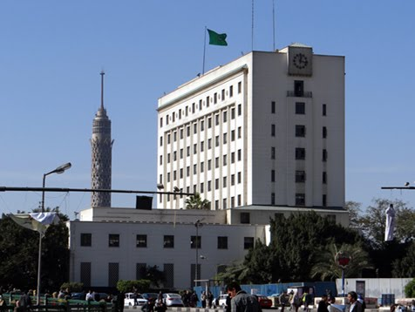
Rotary and the League of Arab States
Notes:
Discuss briefly the location of HQ in Cairo

Slide 17
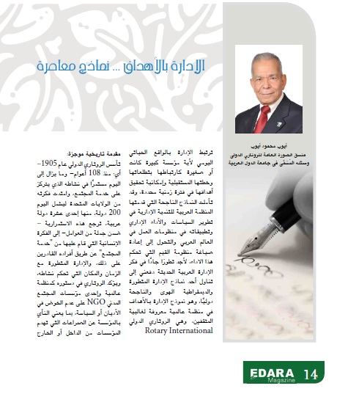
Rotary in Arab League Media
Notes:
Three pages article about Rotary International, in ‘Idara’ , League of Arab States magazine, first quarter 2014 issue

Slide 18
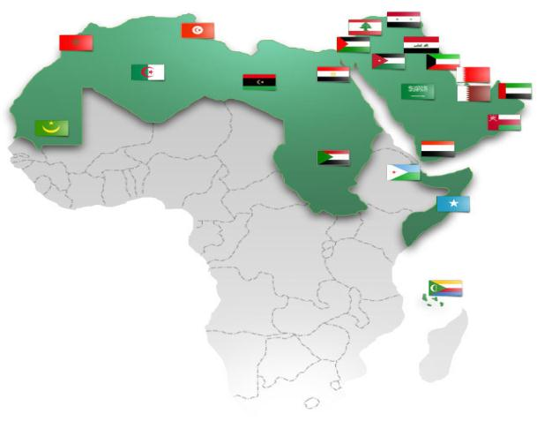
Arab League Member States

Slide 19
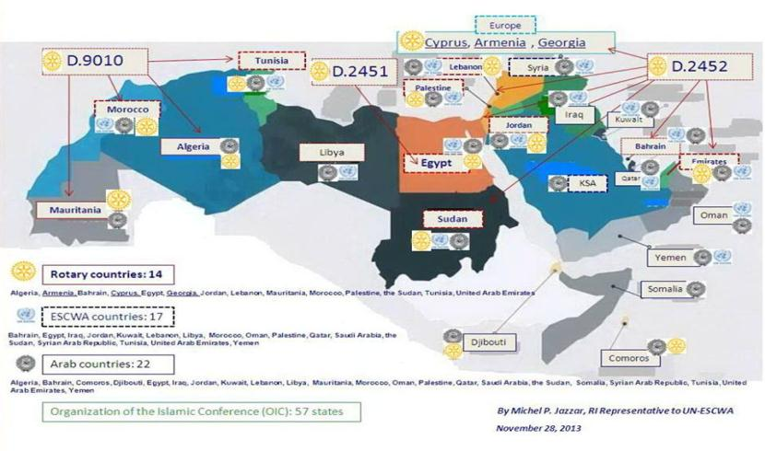
Rotary Zone 20B

Slide 20
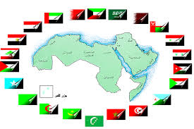
Population of Arab countries with Rotary Clubs
Country | Projection | Percentage of total Arab Population
Egypt | 84,605,000 | 22.81
Algeria | 38,295,000 | 10.32
Sudan | 35,150,000 | 9.47
Morocco | 32,950,000 | 8.88
Tunisia | 10,889,000 | 2.94
UAE | 8,659,000 | 2.33
Jordan | 6,517,000 | 1.76
Palestine[5] | 4,421,000 | 1.19
Lebanon | 4,127,000 | 1.11
Mauritania | 3,461,000 | 0.93
Bahrain | 1,546,000 | 0.42

Slide 21
Population of Arab countries without Rotary Clubs
Country | Projection | Percentage of Total Population
Iraq | 35,404,000 | 9.54
Saudi Arabia | 30,193,000 | 8.14
Yemen | 25,252,000 | 6.81
Syria | 22,169,000 | 5.98
Somalia | 9,662,000 | 2.6
Libya | 6,323,000 | 1.7
Oman | 3,942,000 | 1.06
Kuwait | 3,852,000 | 1.04
Qatar | 1,917,000 | 0.52
Djibouti | 912,000 | 0.25
Comoros | 743,000 | 0.2

Slide 22
Areas of Focus

Slide 23
World Bank
TAKE ACTION, EXCHANGE IDEAS, JOIN LEADERS

Slide 24
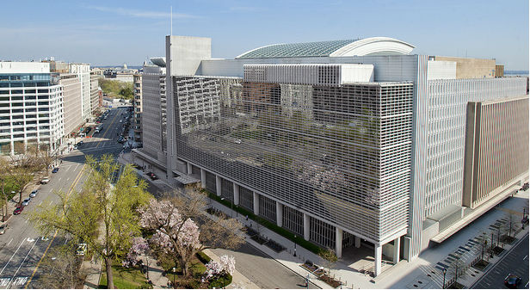
Rotary and the World Bank

Slide 25
Rotary and the World Bank
The Rotary Representatives:
Attend bi-annual meetings of the World Bank
Seek to promote awareness of Rotary’s goals and objectives
Seek to explore partnership opportunities with the World Bank
Notes:
[Need Photo of the World Bank Office]

Slide 26
Rotary and the World Bank
The Representatives:
Facilitate meetings between senior Rotary leaders and senior World Bank officials
Connect with Rotary Alumni employed by the Bank (approximately 25)
Foster opportunities for collaboration with Rotary at all levels within the World Bank

Slide 27
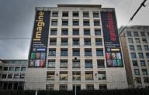
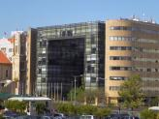
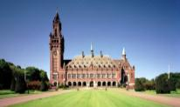
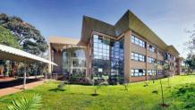
Rotary and the United Nations: Today and Beyond
Notes:
Moderator Peter Kyle will ask the following questions of the Representatives:
What does Rotary offer the United Nations that other non-governmental organizations do not – or cannot?
What risks does Rotary encounter by working with the United Nations?
How can Rotary districts and clubs benefit from the Rotary Representative Network? Representatives can:
Help identify and introduce contacts at in-country offices.
Facilitate speakers and/or facilities for district conferences or other key events (i.e. The Rotary-United Nations Speakers Programme)
Coordinate “Rotary Days” at UN/ New York, UNESCO, FAO, etc.
What should Rotary members around the world expect from the Representative Network in the years ahead?

Slide 28
Questions?
TAKE ACTION, EXCHANGE IDEAS, JOIN LEADERS
Notes:
Peter Kyle moderates the general discussion from the floor.

