Slide 1



ندوة إدارة المنح
RI District 2452
The Rotary Foundation
Grant Management Seminar
1st D. 2452 virtual GMS – June 17, 2020
Moderator: PDG Michel P. Jazzar
RC Kesrouan, Lebanon, D.2452
DRFC chair 2020-21 and 2021-22
RI Representative for UN-ESCWA 2006-2020

Slide 2

The Rotary Foundation
Grant Management Seminar
RI District 2452
2020-21
RY
1st D. 2452 virtual GMS – June 17, 2020
TRF Team chair: PDG Michel P. Jazzar
RC Kesrouan, Lebanon.
DRFC Chair 2020-21 and 2021-22
RI Representative for UN-ESCWA 2006-2020

Slide 3
Welcome addresses.
District Trainer, PDG Ignace Mouawad [2 mns]
DG Mazen Al-Umran [3 mns]

Slide 4
G.M.S 2020-2021 ندوة إدارة المنح
Contributors
DG Mazen Al-Umran [Strategy and Disaster funds]
PP Ghassoub Kawar [Scale Grants]
PP Jocelyn Shidiac [Resources]
PP Jiries Shahine [Global Grants]
PP Iacovos Constantinides [Foundation Grants]
PP Georges Beyrouti [Peace & Water fellowships]
PP Joseph Rachkidi [PolioPlus]
Rot. Khaled El Atawi [Annual Fund Programs]
PP Hassan Al Rais [District Grants]
PP Khaled Tabbarah [TRF mission and programs]
DT/PDG Ignace Mouawad [Apply for grants]
DRFCC/PDG Michel Jazzar [Hints-Qualification]

Slide 5
Why do we have a GMS?
DRFCC Michel Jazzar [5 Minutes]

Slide 6
Why do we have a GMS?
To be a Rotary Club qualified
To enhance our knowledge on Grants
To know Club’s resources
To be a resource for our club

Slide 7
It gives substance
to our
Rotary membership.
Projects must change lives.
Public image
Engagement
Increase Membership

Slide 8
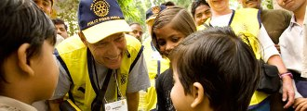
TRF Motto
Doing Good in the World
The Rotary Foundation is our Foundation
Notes:
For many years, the Foundation has tried to be all things to all people, allocating resources across a wide
spectrum of activities. By leveraging resources and focusing them on those areas where Rotarians can be most
effective, the Foundation can enable Rotarians to make a greater, more enduring impact. The remarkable success
of PolioPlus illustrates the value of this approach and provides a model for the future.
▪ Through its partnership with the Gates Foundation, the World Health Organization, UNICEF, and the U.S.
Centers for Disease Control and Prevention, however, Rotary has gained stature in the world of international
development. The Future Vision Plan offers the opportunity to further enhance Rotary’s public image through
focused, high-impact projects and humanitarian causes.
▪ The Rotary Foundation’s programs have not changed significantly since they were established decades ago,
despite enormous changes in the world. As more Rotarians began using Foundation programs, administrative
costs increased; the cost of administering a small grant at times exceeded the amount of the grant itself.
▪ Rotarians have expressed frustration with the current system, calling for a more accessible Foundation,
improved grant application process, and greater autonomy.

Slide 9
This GMS will cover the following

Slide 10
Educational Partnerships with Universities-RPCs & UNESCO-IHE
Apply for Grants?
What is the Qualification?
GMS 2020
Polio eradication our promise for kids
What are the Foundation Grants?
What is the Mission and what are the Foundation programs

Slide 11
What is the Mission and
What are the Foundation programs
PP Khaled Tabbarah
TRF Country Chair – Bahrain [5mns]

Slide 12
The Mission of The Rotary Foundation
Is to enable Rotary members to advance world understanding, goodwill, and peace
through the improvement of health, the support of education, and the alleviation of poverty.
Notes:
Alleviation= Easing=reduce

Slide 13
Grants purpose
The Rotary Foundation offers grants that support a wide variety of projects, scholarships, and training_VTT undertaken by Rotary members around the world.

Slide 14
What are
TRF Grants Programs
Humanitarian Grants Program.
Educational Grants Programs.
PolioPlus Grants Program.

Slide 15
TRF Grants Programs:
Humanitarian Grants Program:
DGr, GGr, SGr, DRGr.
Educational Grants Programs:
RPF, UNESCO-IHE, VTT, Scholarships.
PolioPlus Grants Program:
PolioPlus Grants.
PolioPlus Partners Grants.
Notes:
DGr= District Grants
GGr = Global Grants
SGr= Scale Grants
DRGr=Disaster Response Grants are covered by a special Fund
IHE= Institute of Higher Education [former International Institute for Infrastructural, Hydraulic and Environmental Engineering]
RPF=Rotary Peace Fellowships
VTT=Vocational Training Team

Slide 16
2018-19 GRANT STATISTICS
Worldwide and D.2452
DRFCC/PDG Michel Jazzar [5 mns]

Slide 17
2018-19 GRANT STATISTICS
~1900 Grants = ~125M$
 | Approved | World Fund | Total Funding
District grants | 494 | N/A | $27,753,702
Global grants | 1,403 | $39,187,731 | $97,894,871
Global grant activity type | Number of grants |  | Area of focus | Number of grants
Humanitarian | 1,122 |  | BEL | 174
Humanitarian/VTT | 26 |  | CED | 203
Scholar | 207 |  | DPT | 555
VTT | 48 |  | MCH | 113
 |  |  | PCR | 74
 |  |  | WASH | 284
BEL = Basic education and literacy
CED = Community economic development
DPT = Disease prevention and treatment
^{MCH =} ^{Maternal and child health}
PCR = Peacebuilding and conflict resolution
WASH = Water, sanitation and hygiene
Notes:
BEL = Basic education and literacy
DPT = Disease prevention and treatment
^{MCH =} ^{Maternal and child health}
WASH = Water, sanitation and hygiene
CED = Community economic development
PCR = Peacebuilding and conflict resolution

Slide 18


2018-19 GRANT D. 2452 STATISTICS

Slide 19

2018-2019: 20 GGs and 12 DGs*
20 GGs
Areas of Focus
Lebanon= 14
Jordan= 3
Armenia= 1
Palestine= 1
Turkey +Nicosia-Sarayonou= 1
Disease/medical= 9
Water= 7
Education= 2
Economy dev= 1
VTT= 1
12 DGs
Civic education for peace building:
14 projects: Lebanon – Armenia – Jordan
Gr amount 18170$ [RCs: 67674$]
. COVID-19 : $5856
* October 19, 2017➔ May 16, 2020

Slide 20
by Rotarian Khaled Al Atawi
Annual Programs Fund_APF

Slide 21
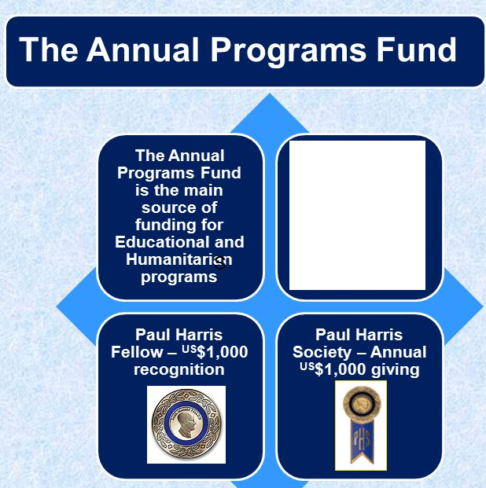

APF and recognition opportunities
Donor recognition
All Annual Fund contributions count toward the following recognition opportunities/Programs:
Every Rotarian Every Year
Rotary Foundation Sustaining Member
Paul Harris Fellow_PHF
Paul Harris Society_PHS
Major Donor_MD
Arch Klumph Circle Society
P
R
O
G
R
A
M
S
Major Donor

Slide 22
AF and EREY
Contribute AF
Participate in grants
Foundation activities
Annual Fund-SHARE is the primary source of funding for a broad range of local and international Rotary Foundation activities.
Every Rotarian, Every Year (EREY) is the fundraising initiative designed to encourage support for the Foundation’s Annual Fund.
EREY aims to engage every Rotary club member by:
Encouraging members to contribute to the Annual Fund every year
Encouraging them to participate in a Foundation grant or program every year
Notes:
The Annual Programs Fund (APF) is the lifeblood of our Foundation. Contributions to APF give strength to our programs each year because they carry the "brand identity" of Rotarians. ... It is our "Every Rotarian, Every Year" contributions to the APF that support all of our educational and humanitarian programs.

Slide 23
Funding
Grants
by DRFCC PDG Michel Jazzar [10 mns]

Slide 24






Rotary Foundation Funding
Rotarian
Contributions
& Fundraising
TRF Funding
District Designated Fund
(DDF)
• Every Rotarian, Every Year
• PH Sustaining Member
• Paul Harris Fellow
• Paul Harris Society
• Major Donor
• Arch C. Klumph Circle Society
SHARE
50%
50%
World Fund
• Bequest commitments
• Life insurance
• Marketable securities
• Real estate
• Charitable trusts or annuities
• Benefactor
• Bequest Society
• Major Donor
• Arch C. Klumph Society
Investment Earnings

Slide 25
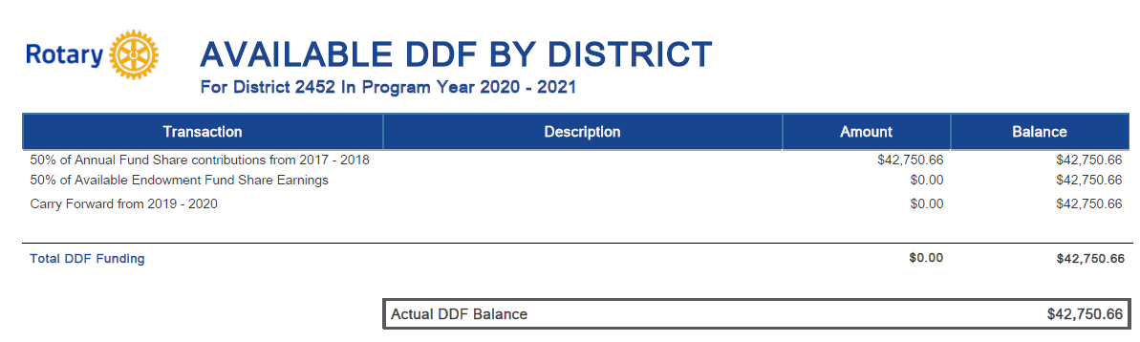
DDF 2020-2021 [as 16 May 2020]
$ 42.750.66

Slide 26
e.g. Distributable Funds
2020 – 2021 Program Year
Annual Programs Fund Contributions 2017–2018
+
Permanent Fund SHARE earnings
+
Carry forward RY 2019-20
= $42.750.66
DDF
Not yet known on 16 June 2020
Notes:
District grants are funded solely by DDF generated from a district’s Annual Programs Fund giving from three years prior, including Permanent Fund SHARE earnings.
Districts can request up to 50 percent of their DDF each year.
Any unused district grant funds are returned to the Foundation and credited back to the district's DDF balance.
DDF will continue to rollover to a district's balance for the following year. Rollover DDF will not be used in the calculation of the district grant amount.

Slide 27
Permanent Fund Earnings
The Trustees determine the spendable percentage of earnings. If a district has contributions designated to Permanent Fund-SHARE, the earnings are split:
50% to the World Fund
50% credited to the District’s DDF [unknown 30 May 2020]
Amount unknown on 16 June 2020

Slide 28
Carry forward RY 2019-20
Amount unknown on 16 June 2020

Slide 29
SHARE System
CCP
Michel
Shawkat
Mazen
Ashot
2017-18
2018-19
2019-20
2020-21
2021-22
Funds Raised
Funds Spent
Unused DDF 2019-2020 is calculated;
districts notified in August 2020
Unused DDF rolls forward 2020-2021
to the next year; districts notified in August 2021

Slide 30
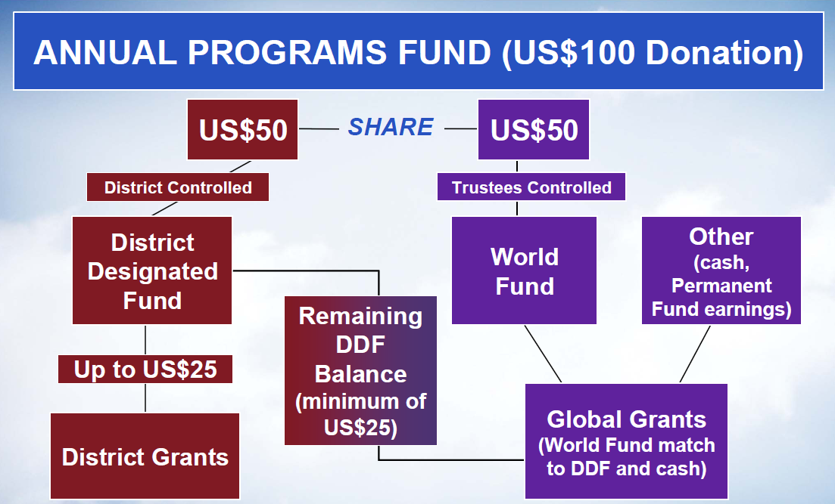
1/7/2020
)

Slide 31
Distributable Funds 2020 – 2021 Program Year
Annual Programs Fund Contributions [ 50% of 2017 – 2018]
Annual Program Fund: $ 40.750.66
50% SHARE 50%
DDF DDF
$20,375.33 $20,375.33
0%
PolioPlus
75%
+
25%
$15,281.50
DGrants
GGrants
$0,00
$5,093,83
$35,656.83

Slide 32
Who was involved in planning?
District governor 2020-21
District governor-elect 2021-22
District Rotary Foundation committee chair-DRFC 2020-2021, 2021-2022
3 District Rotary Foundation subcommittee chairs: APF/GGs/DGrs
Notes:
Annual Programs Fund = APF

Slide 33
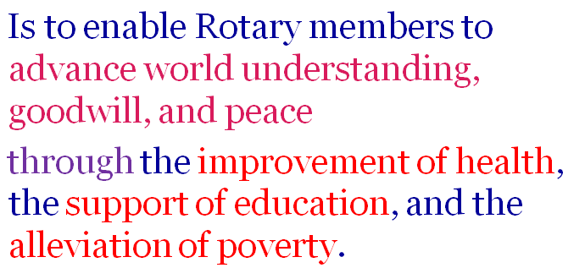
To what Grants are related ?
Grants
Funding
Per Grant or per year
DGrants 2014
GGrants 2014
SGrants 2020
DRGrants
EGrants
PPGrants 1985
Mission of TRF
➔ 10.000$
Areas of Focus
➔ 400.000$
number of people in
a significant geographic area
➔ 2.000.000$
Area of Focus
Affected area
➔ 25.000$
2002
2011
Peace and Water management
➔ 40.000$
Polio-endemic countries
➔ +50.000.000$
DR Fund: Disater Response Fund
EGrants: Educational Grants
Notes:
DR Fund: Disater Response Fund
EGrants: Educational Grants
À quoi les subventions sont liées

Slide 34
What are the
Foundation Grants?
by PP Iacovos Constantinides
TRF Country chair – Cyprus [10 mns]

Slide 35

GLOBAL GRANTS
Large, long-term projects
Sustainable, measurable outcomes
Alignment with areas of focus
International partnership
$30,000 minimum budget
$15,000 minimum grant
World Fund match only DDF
Notes:
Global grants support large international activities with sustainable, measurable outcomes in Rotary’s areas of focus. A key feature of global grants is partnership, between the district or club where the activity is carried out and a district or club in another country. Both sponsors must be qualified before they can submit an application.
The minimum budget for a global grant activity is $30,000. The Foundation’s World Fund provides a minimum of $15,000 and maximum of $200,000. Clubs and districts contribute District Designated Funds (DDF) and/or cash contributions that the World Fund matches. DDF is matched at 100% and cash is matched at 50%.
Global grants can support humanitarian projects, scholarships, and vocational training teams. Global grant scholarships support international graduate and post-graduate study for a period of 1-4 years. Global grant vocational training teams support groups of professionals to travel abroad to provide or receive training.

Slide 36
Global Grants new options:
1-to respond to outbreak
2-in Partnership
Notes:
As people of action, Rotary members want to find ways to respond to COVID-19, and to help people affected by it. The Rotary Foundation offers several options that Rotarians can use to help care for and protect people in their own communities and others around the world.

Slide 37
GG to respond to outbreak: COVID-19
1
https://www.rotary.org/en/rotary-monitors-coronavirus-outbreak#grants
Global grants remain an excellent way to make a transformative impact in a community.
If medical equipment is needed in order to respond effectively to COVID-19, global grants can help pay for these items.
The Foundation is waiving the 30% foreign financing requirement for any new global grant that addresses COVID-19. Note that these grants still require both a host and international partner.
Contact your regional grants officer.
2019-2020
https://my.rotary.org/en/take-action/apply-grants/global-grants

Slide 38


Hearts of Europe Global Grants*
2
GGs in Partnership with
The host sponsor:
Albania, Armenia, Azerbaijan, Belarus, Bosnia and Herzegovina, Georgia, Kosovo, Moldova, Montenegro, North Macedonia, Serbia, and Ukraine.
The international sponsor for the grant:
must be a club or district in the United States.
*https://my.rotary.org/en/hearts-europe-global-grants

Slide 39
Hearts of Europe Global Grants*
The Hearts of Europe initiative, funded jointly by USAID and the Rotary Foundation, is a three-year program that aims to foster collaboration, networking, and friendship among Rotary clubs in select Eastern European countries and the United States.
*https://my.rotary.org/en/hearts-europe-global-grants
Notes:
Regional Grants Officers Lauren Sterenberg : Armenia, Georgia.

Slide 40
Hearts of Europe Global Grants*
Rotary clubs and districts that apply to sponsor these grants may receive a double World Fund match.
For example, if they request $15,000 from the World Fund, they can receive up to an additional $15,000 for a total of $30,000 in matching funds.
*https://my.rotary.org/en/hearts-europe-global-grants

Slide 41
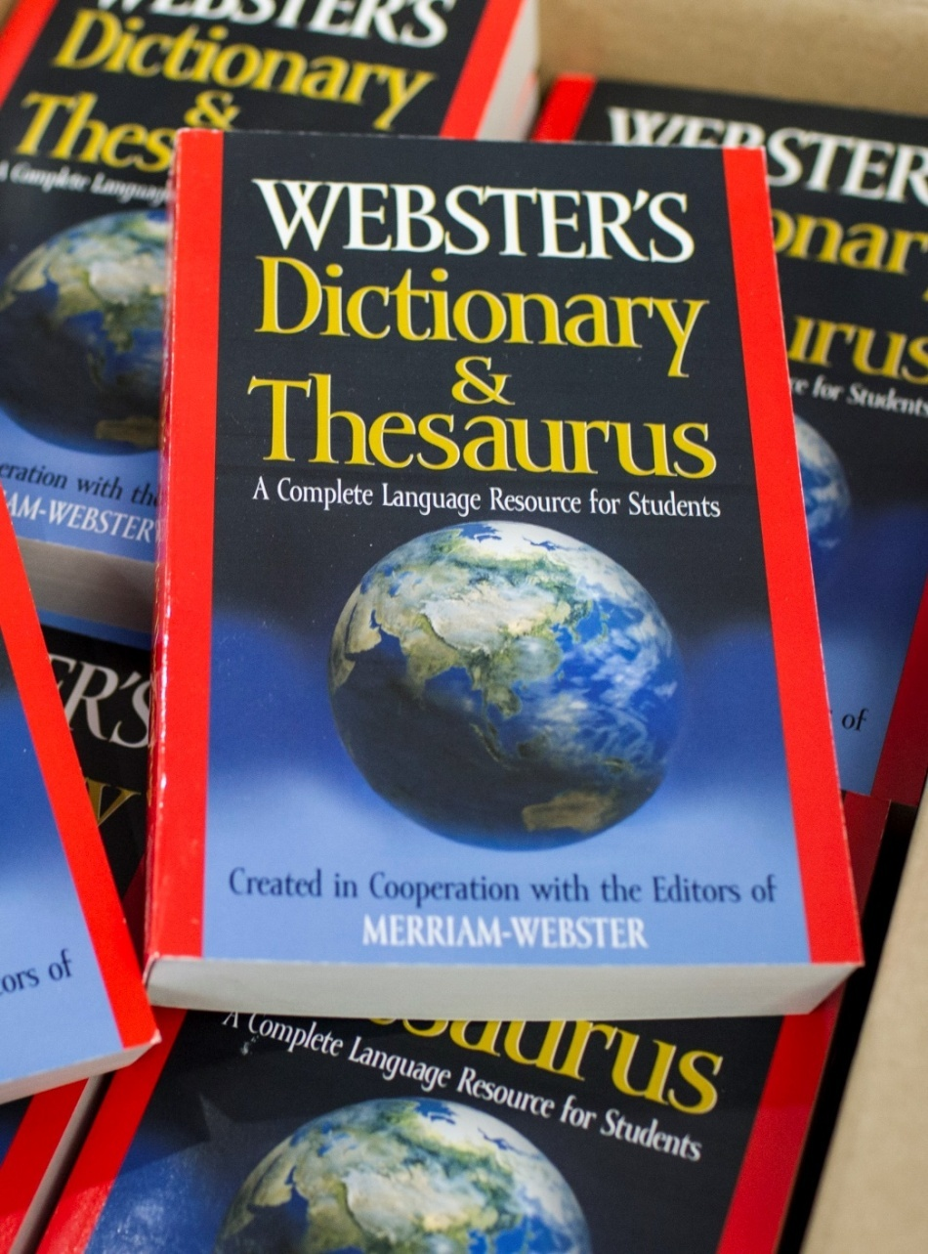
DISTRICT GRANTS
Small-scale, short-term
Local or international activities
Aligned with the Foundation’s mission
Single grant awarded annually
Notes:
Now that we’ve talked about global grants, I’d like to shift gears and talk about the second type of grant that’s available from The Rotary Foundation: district grants.
District grants fund small-scale, short-term activities that address needs in your community and communities abroad. Each district chooses which activities it will fund with these grants. You can use district grants to fund a variety of district and club projects and activities.
You have a lot of freedom to customize your service projects. There aren’t many restrictions, as long as your district grant supports the mission of The Rotary Foundation, which is to enable Rotarians to advance world understanding, goodwill, and peace through the improvement of health, the support of education, and the alleviation of poverty. Districts must be qualified before they can administer district grants.
Districts may use up to 50 percent of their District Designated Fund to receive one district grant annually. This percentage is calculated based on the amount of DDF generated from a district’s Annual Fund giving three years prior, including Endowment Fund earnings. You aren’t required to request the full amount available. Districts receive this funding as a lump sum and then distribute it to their clubs.
District grant funding can support local service projects, international humanitarian projects, scholarships and vocational exchanges. Unlike global grant scholars, district grants can support scholarships at any level of study and for any study area. Similarly, vocational exchanges funded by district grants have great flexibility and don’t need to align with any specific topic area or provide formal training.

Slide 42
Reminder: The Mission of TRF
Is to enable Rotary members to advance world understanding, goodwill, and peace
through the improvement of health, the support of education, and the alleviation of poverty.
Notes:
Alleviation= Easing=reduce

Slide 43
DGrants to respond to COVID-19
Districts can use district grant funds to support local activities, like purchasing thermometers, protective medical gear, or other items to donate to medical professionals who need them.
Districts can also use contingency funds from an open district grant or repurpose previously planned activities as a COVID-19 response. [amount carry on from RY 2019-2020]
As districts prepare to submit new district grant applications for 2020-21, TRF encourages Districts to designate funds for COVID-19 responses, ➔ 2452 DG choice.
As a one-time exception, the Foundation will allow expenses related to COVID-19 that were incurred since 15 March 2020 to be reimbursed through 2020-21 district grants.
https://my.rotary.org/en/take-action/apply-grants/district-grants
Notes:
contingency funds = fonds de prévoyance = صناديق الطوارئ

Slide 44
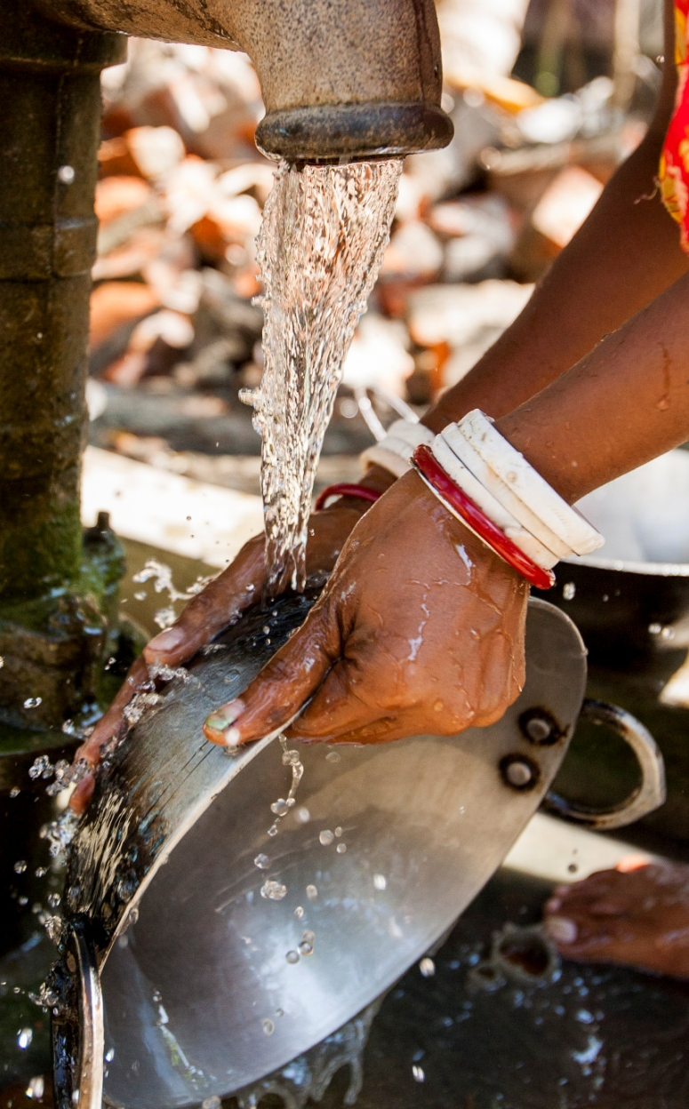
PROGRAMS OF SCALE GRANTS
برامج المِنح العالية
Long-term activities that benefit large number of people
Alignment with areas of focus
World Fund award of $2 million; NO additional Rotarian funding required
Implemented with partner organization(s)
Competitive two-step application process تنافسية
Notes:
Programs of scale grants are a new type of grant that supports long-term activities (lasting three to five years). Funded activities must benefit a significant geographic area (a multinational, national, regional, or district-wide reach) or affect a large number of people. These grants are aligned with one or more of Rotary’s areas of focus. The grant award amount is $2 million, but applicants may have a budget that exceeds this amount that will be funded through additional resources from implementing partners and/or other sources. No additional Rotarian funding is required.
One of the unique features of these grants is that they must be implemented with a partner organization. In addition, these grants will only fund fully developed activities that have been used successfully previously. New or untested activities aren’t eligible.
Another feature that distinguishes programs of scale grants from other Foundation grants (notably global grants) is that they don’t require an international Rotarian partner. However, the sponsoring club or district must be actively involved in the project.
The Rotary Foundation will award one to two grants each year in a competitive, two-step process that includes a proposal and application. The process begins January 2020 and the initial selection will be made at the October/November 2020 Rotary Foundation Board of Trustees meeting.

Slide 45
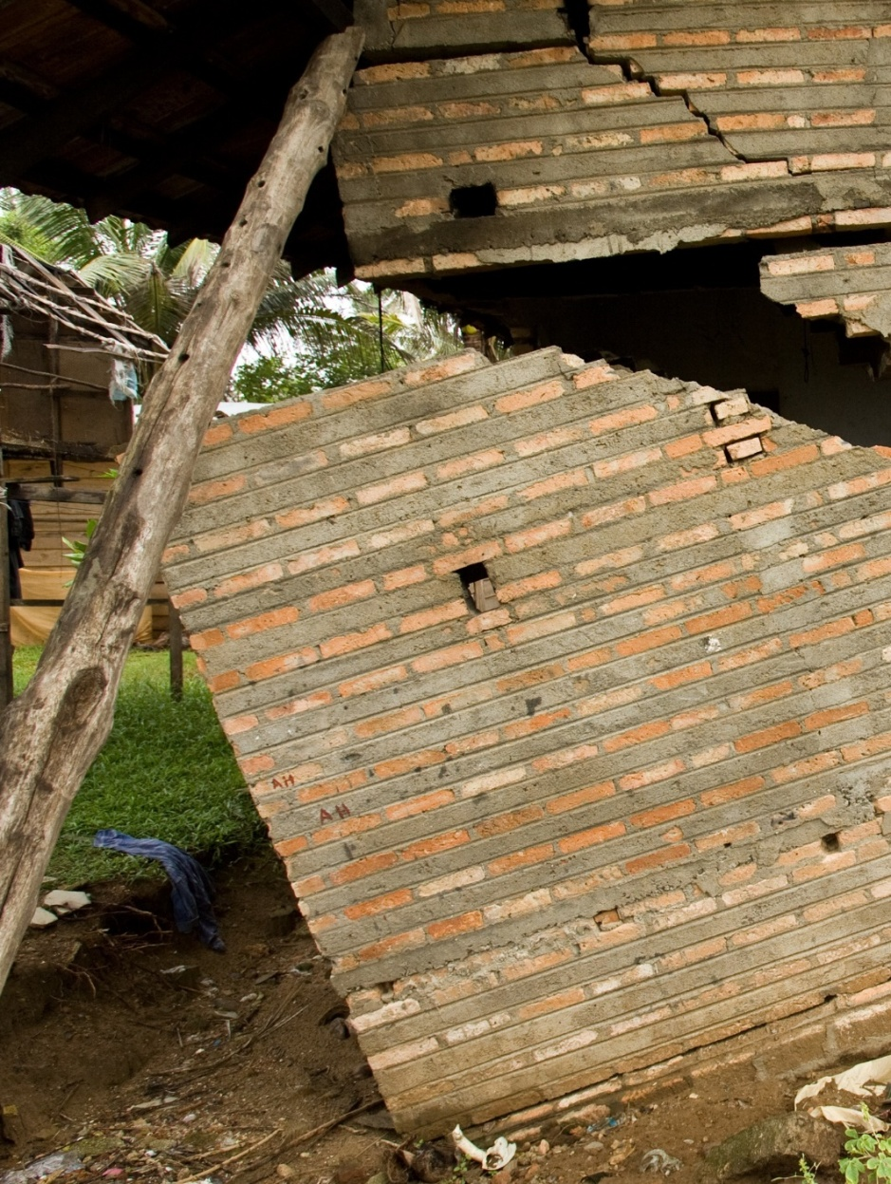
DISASTER RESPONSE GRANTS
Support relief and recovery efforts in areas affected by natural disaster
Funded by contributions to the Rotary Disaster Response Fund
Notes:
Now I’d like to share some information about our newest grant type: disaster response grants. These grants support relief and recovery efforts in areas affected by natural disaster. Qualified districts in affected areas may apply for grants of up to $25,000, based on the availability of funds.
Districts that request help are responsible for determining the needs in communities affected by disaster. They should work closely with local officials and community groups to ensure that the funding meets those needs. To apply, the district governor and district Rotary Foundation chair complete the Rotary Disaster Response Grant Application and send it to grants@rotary.org.
These grants are funded by contributions to the Rotary Disaster Response Fund. The fund can accept cash contributions and District Designated Funds (DDF). It is a general disaster-related reserve, and contributions cannot be designated for specific events.

Slide 46
Disaster Response Grants &
Rotary’s Disaster Response Fund
Rotary’s disaster response grants provide a fast and effective way to respond to local events. The Rotary Foundation recently added COVID-19 projects to its list of eligible activities for these grants.
Each district can apply for one grant (of up to $25,000) to address COVID-19, depending on the availability of funds. Disaster response grants are funded by the Rotary Disaster Response Fund to help districts around the world respond to disasters.
The fund accepts online contributions and DDF. Districts may designate that their DDF contributions to the Disaster Response Fund be used exclusively for COVID-19 grant activities. Cash contributions will be used for general disaster response, including response to COVID-19.
https://my.rotary.org/en/take-action/apply-grants/rotary-disaster-response-grants

Slide 47
DGr 2020 ➔ C19P
The Rotary Foundation has approved more than $4.7 million in disaster response grants to address the COVID-19 Pandemic.

Slide 48
Apply for grants
by DT PDG Ignace Mouawad [10 mns]

Slide 49
Where to go to get information?
Where to go to download material?
Where to go to apply for GGs, DGrs, SGs, TGs?
Notes:
TGs= Travel Grants

Slide 50
Where to go to get information?
Where to go to download material?
Where to go to apply for GGs, DGrs, SGs, TGs?
Notes:
TGs= Travel Grants

Slide 51
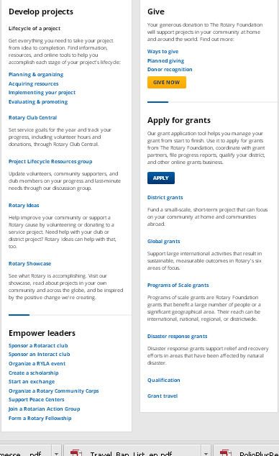
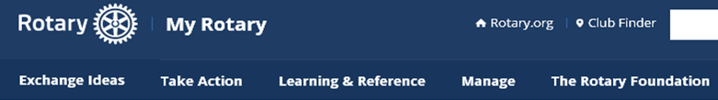

Click on
“Take Action”
District Grants
Global Grants
Scale Grants
Disaster Response Grants [Funds]
Grant for Travel

Slide 52
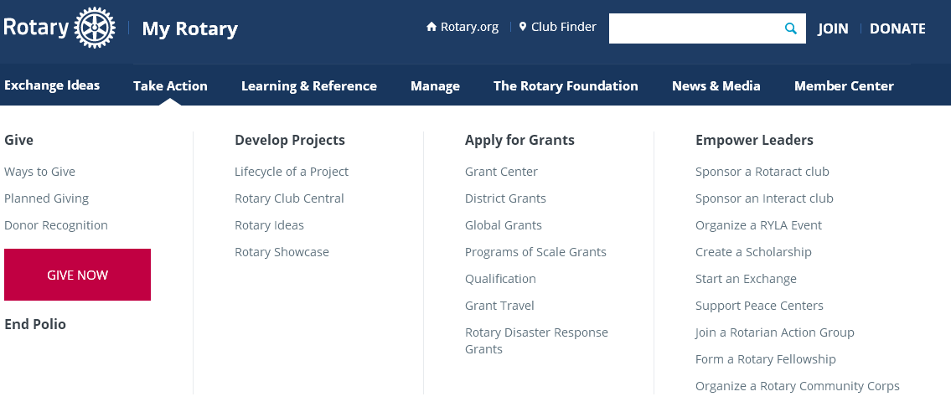
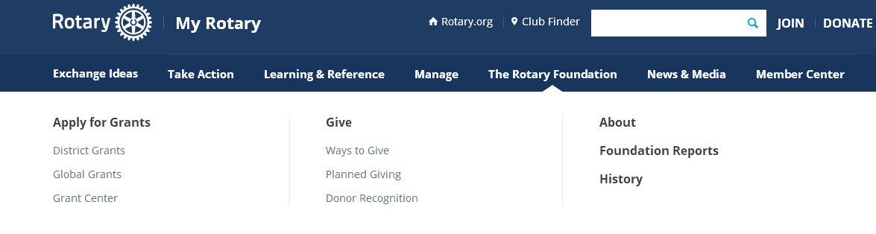
Resources
https://my.rotary.org/en/take-action/apply-grants
How to go there?
My Rotary ➔ Take action ➔Apply for Grants
My Rotary ➔ Rotary Foundation ➔Apply for Grants

Slide 53
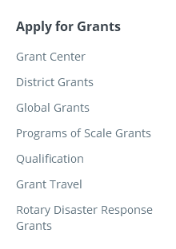
Resources:
https://my.rotary.org/en/take-action/apply-grants
How to go there?
My Rotary ➔ Take action ➔Apply for Grants
5
Grants

Slide 54
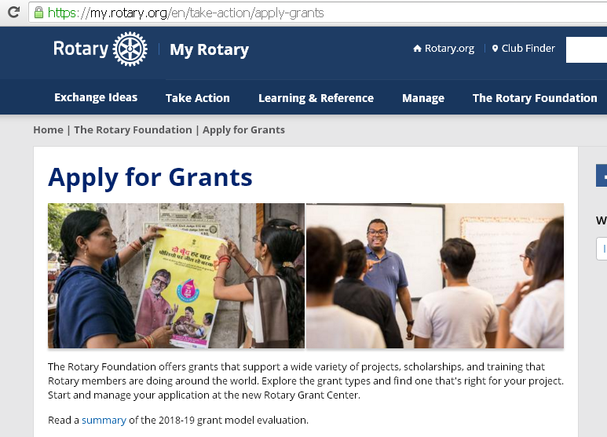
https://my.rotary.org/en/take-action/apply-grants
Webpage to Apply for Grants_1

Slide 55
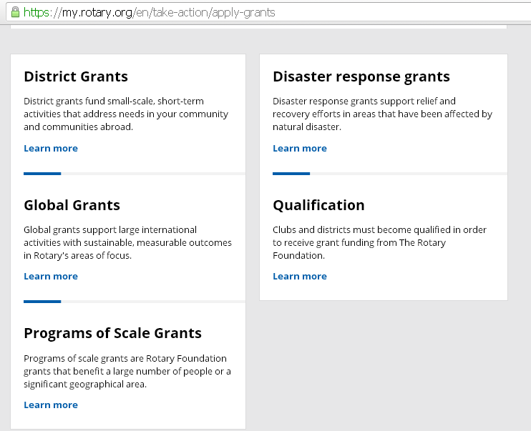

Webpage to Apply for Grants_2
Not included into this page

Slide 56
Apply for GGrs?
Where to
You apply online Grants Center on www.rotary.org ➔ My Rotary ➔ Grants
Notes:
Support large international activities that result in sustainable, measurable outcomes in Rotary's six areas of focus.

Slide 57
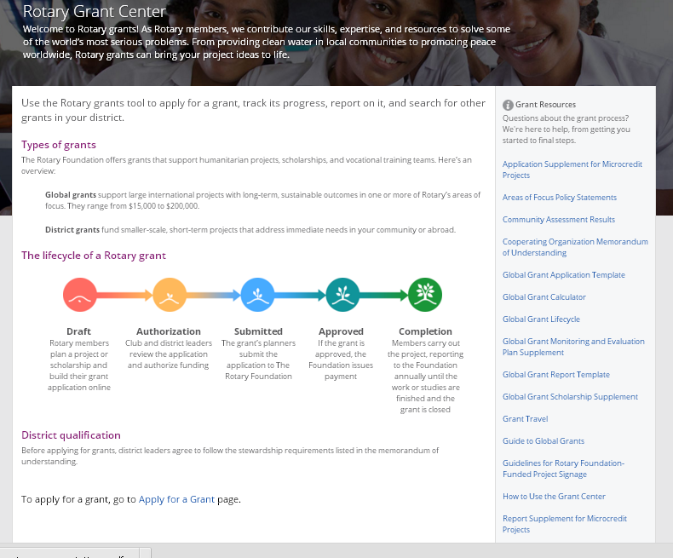

Slide 58
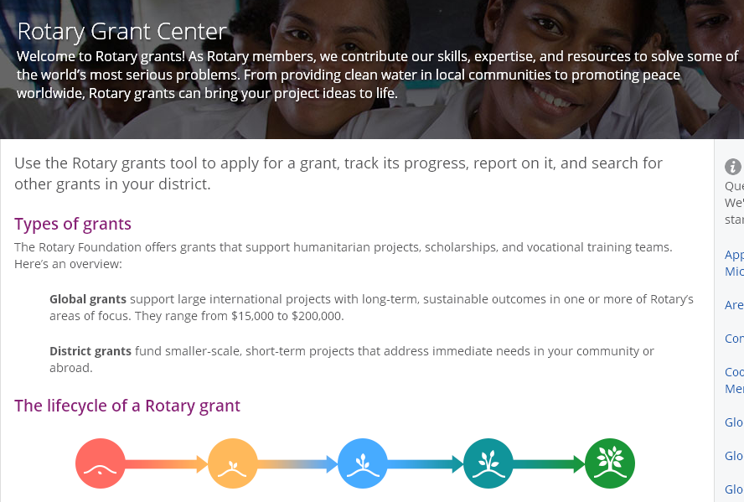
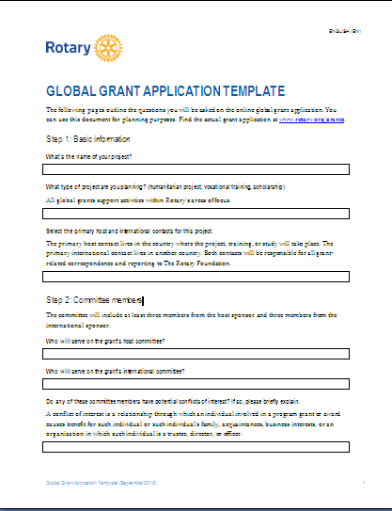
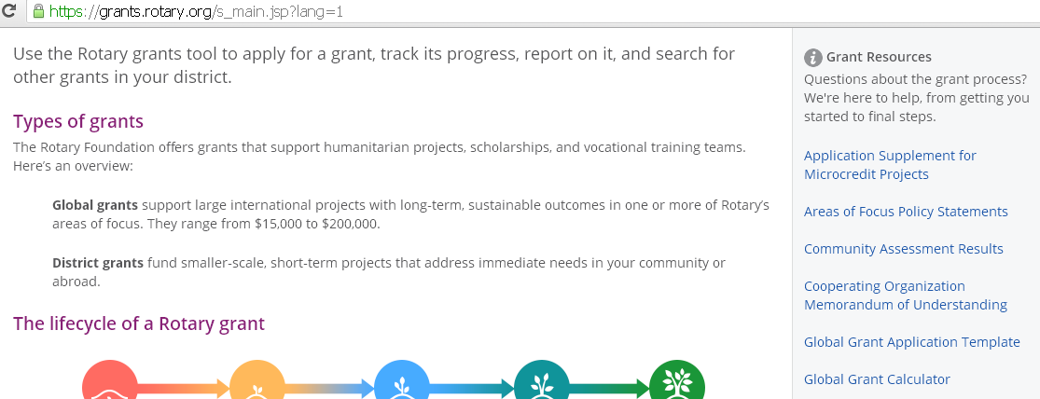
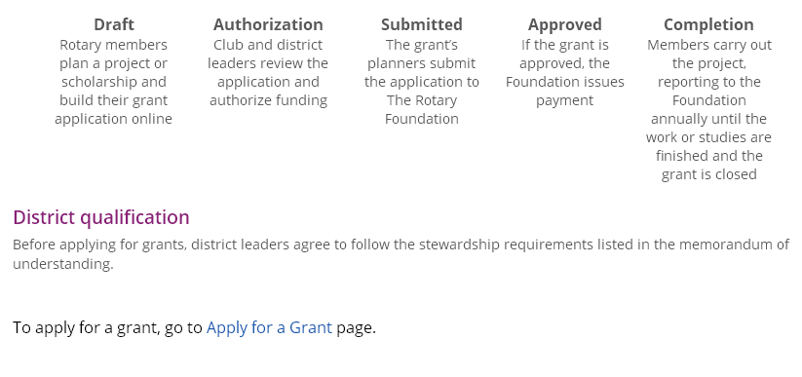
RCs
DGs
Where do you find it?
TRF Committee
Officers clubs and Districts
Lock your application online
Approved by TRF
TRF STAFF
Download the newest copy – Sept 2019

Slide 59
How to fill a GGr Application Form for RY 2020-2021 and use the GGs calculator?
Shall be explained during TRF Foundation country Seminar, as the new calculator for GGs is not yet updated on the RI website.

Slide 60
Apply for District Grants
by PP Hassan Al Rais
Grants District chair

Slide 61
Where to go to get information?
Where to go to download material?
Where to go to apply for GGs, DGrs, SGs, TGs?
Notes:
TGs= Travel Grants

Slide 62
Where & How to apply for DGrs?
Fund a small-scale, short-term project that can focus on your community at home and communities abroad.
You apply to the District Governor, according to a letter sent by the DGrants subcommittee grants chair with criteria, projects-COVID19, contribution from RC equals the district contribution + timeline.
District contribution?➔ c/o strategy D2452 for RY 2020-21 [coming slides]

Slide 63
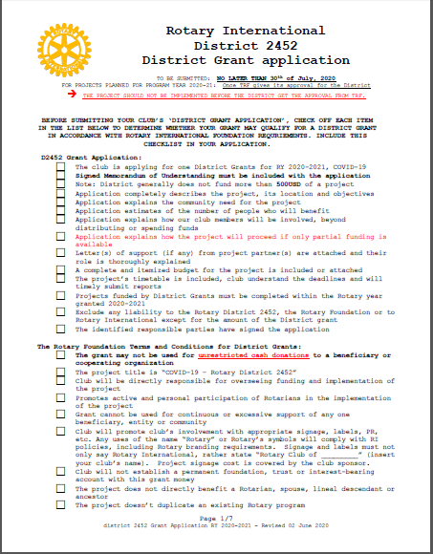
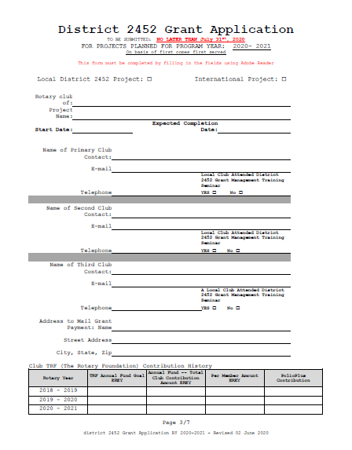
Check list and A.F for RY 2020-2021
Notes:
AF=Application Form

Slide 64
District 2452 Grant Application
TO BE SUBMITTED: NO LATER THAN July 31st, 2020
FOR PROJECTS PLANNED FOR PROGRAM YEAR: 2020- 2021
On basis of first comes first served
This form must be completed by filling in the fields and by signing it

Slide 65

Scale Grants program
by PP Ghassoub Kawar
Scale Program Grant chair- [5 mns]

Slide 66
Where to go to get information?
Where to go to download material?
Where to go to apply for GGs, DGrs, SGs, TGs?
Notes:
TGs= Travel Grants

Slide 67
Programs of Scale Grants
Programs of scale grants are Rotary Foundation grants that benefit a large number of people or a significant geographical area. Their reach can be international, national, regional, or district wide.
2,000.000 USD, worldwide competition, to be implemented into 3-4 years involving different clubs and/or countries.
Clubs and Districts may apply.
Notes:
And that’s the type of project programs of scale was designed to support. Programs of scale will award a single $2 million grant every year, and in my view will bring about the same transformative change in our Foundation projects as the 3-H program did when it was introduced in 1978 by Clem Renouf.
Remember that’s how PolioPlus began in the Philippines. But you will learn more about this in due course. […]
Ravi Ravindran at IA 2020

Slide 68
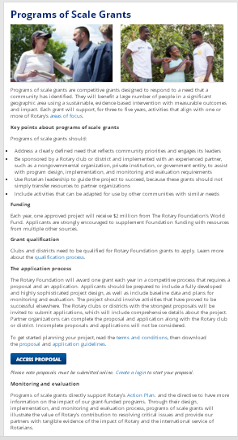
Apply for SGs
https://my.rotary.org/en/take-action/apply-grants/programs-scale-grants
Started January 2021
Jan. 2021
March 2021
Documents
Information
Decision by TRF Trustee October-November meeting 2021.
SG to be implemented 2022-2026
Applying

Slide 69
Where to go to get information?
Where to go to download material?
Where to go to apply for GGs, DGrs, SGs, TGs?
Notes:
TGs= Travel Grants

Slide 70
Grant Travel
By RFCC/PDG Michel Jazzar [5mns]

Slide 71
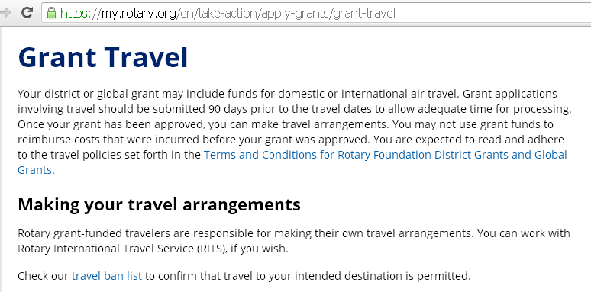
Where to apply for Grant Travel?
The district grant or a global grant may include funds for domestic or international air travel.
https://my.rotary.org/en/take-action/apply-grants/grant-travel

Slide 72
TRAVEL BAN LIST [1 Dec. 2019]
Funded travel for Staff, Volunteers, Program Participants and Grant travelers is suspended for the following countries :
Afghanistan
Iran
Pakistan
North Korea
Burkina Faso
Burundi
Central African Republic
Dem Rep. of Congo
Mali
South Sudan
Gaza
Iraq
Libya
Somalia
Sudan
Syria
Yemen
Venezuela
4
7
6
1

Slide 73
TRAVEL BAN LIST [2020]
Funded travel for Staff, Volunteers, Program Participants and Grant travelers is suspended for the following countries :
BECAUSE OF C19P:
TRAVEL BAN FOR ALL COUNTRIES TILL FURTHER NOTICE.
Notes:
C19P= Covid 19 Pandemic

Slide 74
Apply for
Disaster Response Grants
by DG Mazen Al-Umran [5 mns]

Slide 75
Disaster Response Grants
Disaster response grants support relief and recovery efforts in areas that have been affected by natural disaster.
The Governor applies for the District.
The Governor may apply for a country.

Slide 76
How to apply for Rotary Disaster Response Grants_DRG?
Who can apply for a disaster response grant?
Once qualified for Rotary grants, districts in an affected area or country may apply for a maximum grant of $25,000, based on the availability of funds.
How to apply?
The district governor and district Rotary Foundation chair complete the Rotary Disaster Response Grant Application and send it to grants@rotary.org.

Slide 77
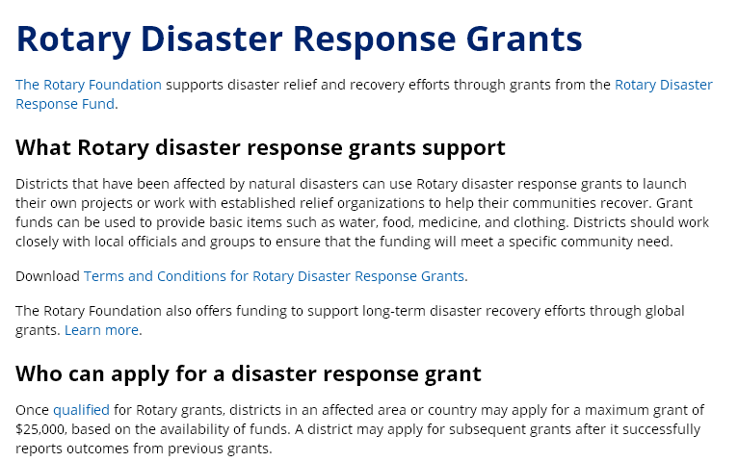
Resources on Rotary.org
https://my.rotary.org/en/take-action/apply-grants/rotary-disaster-response-grants

Slide 78
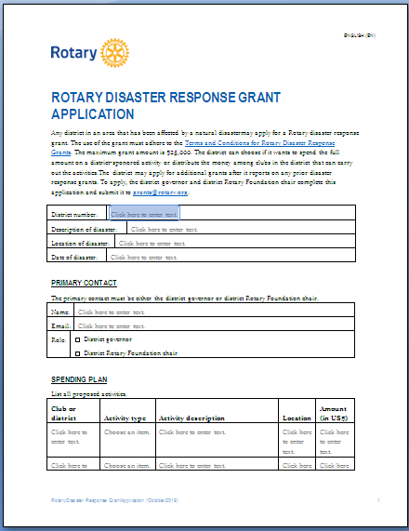
Rotary Disaster Response Grant Application5 pages

Slide 79
Educational Grants
TRF Partnership : 2 examples
Peace and Water Fellowships
by PP George Beyrouti
RPF-W.F District chair [10mns]

Slide 80


Slide 81
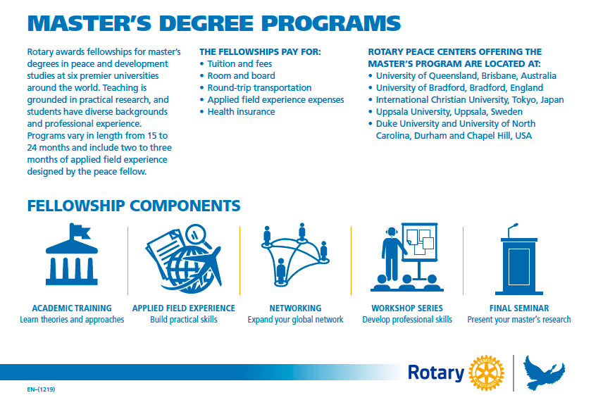
5 RPCs, 6 Universities
Master presentation
Theories
AFE
Networking
Workshops

Slide 82

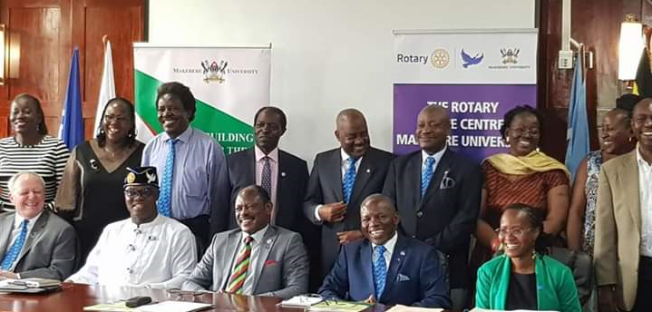
New:
One year term
2 RPCs, 2 Universities
The program will incorporate the Positive Peace framework pioneered by the Institute for Economics and Peace (IEP) http://economicsandpeace.org/ as well as apply concepts grounded in mediation and negotiation, African philosophy, and indigenous mechanisms for conflict resolution.
accepted in 2020
and
the first class
will start in 2021
9 January 2020
Notes:
Capstone= Councilors have put the finishing touches to the document which will be sent to residents in three zones in the borough next month.

Slide 83

18-month Master of Science degree
https://www.un-ihe.org/sites/default/files/carousel_images_overlay/2020-2022_rotary_scholarship_for_water_and_sanitation_professionals_at_ihe_delft_-_application_form_va.pdf
Notes:
DELFT, The Netherlands (24 April 2014) — The first class of five Rotary sponsored scholars has graduated with Master of Science degrees in water education from the UNESCO-IHE Institute for Water Education. The graduates now will apply their education to water and sanitation projects in their home countries of Argentina, Uganda, Nigeria, Ethiopia and Ghana.
Established in 2011, the partnership between Rotary and UNESCO-IHE -- the world’s largest graduate water education facility -- addresses the global water and sanitation crisis by increasing the ranks of trained professionals critically needed to devise, plan and implement solutions in countries where communities lack access to clean water and safe sanitation. Rotary provides scholarship grants that enable local Rotary clubs and districts to select and sponsor eligible students to the program. Rotary members mentor the students throughout the program, building positive relationships that continue after graduation.

Slide 84
18-month Master of Science degree
Urban Water and Sanitation,
Water Management and Governance,
Water Science and Engineering.

Slide 85
Application Process for 2021-2023 Rotary Scholarships
The deadline for applying for admission to one of the IHE eligible MSc programs is 01 April 2021 [to Rotary clubs]
and for submitting Rotary-scholarship applications is 15 April 2021. The AF has to be submitted by email to the Rotary/IHE Delft committee in the Netherlands: rotary.ihescholarship@gmail.com
Only specializations of the following IHE Delft MSc programs are eligible for a 2021-2023 Rotary Scholarship:
Urban Water and Sanitation,
Water Management and Governance,
Water Science and Engineering.
Candidates will be informed about the outcome (< 01 July 2021).
https://www.un-ihe.org/sites/default/files/rotary_brochure_03092019.pdf
https://www.un-ihe.org/rotary-scholarships-water-and-sanitation-professionals

Slide 86
Educational partners
Each year, The Rotary Foundation awards up to 50 fellowships for master’s degrees and 80 for certificate studies at premier universities.
Each year, The Rotary Foundation awards between 6 and 10 fellowships water management for master’s degrees
Master’s program university partners [+Eligibility]
Duke University and University of North Carolina at Chapel Hill, USA [2 U and 1 RPC]
International Christian University, Tokyo, Japan
University of Bradford, Bradford, England
University of Queensland, Brisbane, Australia
Uppsala University, Uppsala, Sweden
Each year, The Rotary Foundation awards between 6-10 fellowships for master’s degrees for water management
Certificate’s program university partners [+Eligibility]
Chulalongkorn University, Bangkok, Thailand
Makerere University, Kampala, Uganda
The specializations of the following IHE Delft MSc programs are eligible for a 2020-2022 Rotary Scholarship:
Water Management and Governance
Urban Water and Sanitation
Water Science and Engineering
~140 Peace Fellowships
6-10 Water Fellowships
Ms: 6 Universities
5 RPCs
Ms: 1 University
PDC: 2 Universities
2 RPCs

Slide 87


PolioPlus Grants Program
by PP Joseph Rachkidi
PolioPlus District chair [5mns]

Slide 88
Extend partnership with BMGF for +3 years
The Gates Foundation will continue matching donations to Rotary’s PolioPlus program 2-1, up to $50 million every year.
Through the extension of the funding partnership forged more than a decade ago, the expanded agreement will translate into up to $450 million for additional polio eradication efforts. [3x (50+100)]
Notes:
https://cdn2.webdamdb.com/md_PFPxbyLG4647.mp4?1579703641

Slide 89
PLUS is….
When we talk about PolioPlus, we know we are eradicating Polio, but do we realize how many benefits the program brings?
It is Prevention
The “PLUS” is something else that is provided as a part of the polio eradication campaign that is improving lives.

Slide 90
What might be the “PLUS”?
Aspects of the GPEI’s endgame strategy: 2019-2023
It might be:
Hand-operated tricycle [local product]
Access to clean water_cw
Funding solar-powered boreholes for cw
Additional medical treatment : Vitamin A
Bed nets [malaria]
Soap , hygiene , sanitation and health camps
Nutrition.
Jobs like educating others by door-to-door, earning money to have a small business [e.g. store].
Notes:
Boreholes=forages

Slide 91
Our contributions go to:
Prevention from Poliomyelitis
Improving lives (>< Polio)

Slide 92
Miscellaneous
by PP Jiries Shahine
TRF Country chair – Jordan [5 mns]

Slide 93
Hints for grant’s description
Humanitarian
Aligned to 1 or more of the 6AOF
Community needs
People empowerment
Sustainability
International partner/s: fund [30%]+ relation/club to club/between members
It gives substance to your RC Membership➔ Engagement
Members Change lives for better ➔ Image
Notes:
Hints = suggestions
International sponsors for humanitarian projects are required to provide at least 30% of the total sponsor funding.
This 30% requirement is based on the total contributions (cash and DDF) from the grant sponsors, and not on the total budget amount.

Slide 94
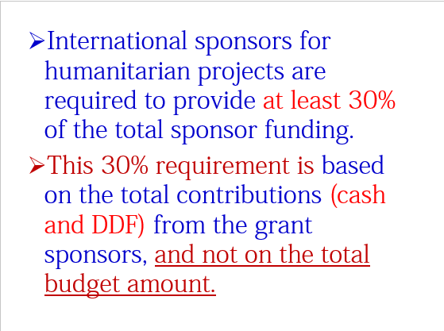
Hints for grant’s description

Slide 95
How to use the Excel sheet to calculate the GG budget?

Slide 96
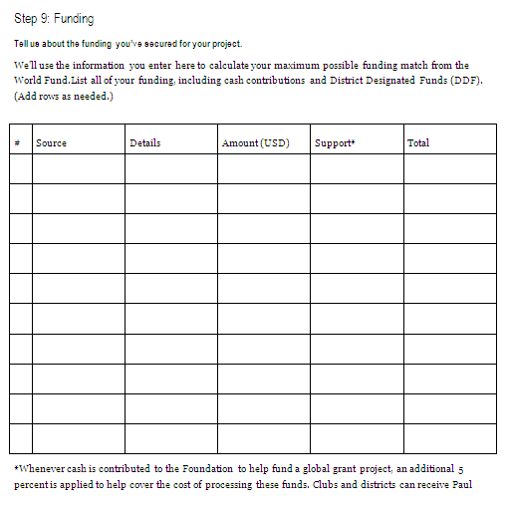
RCs
DGs
Where do you find it?
TRF Committee
Officers clubs and Districts
Lock your application online
Approved by TRF
TRF STAFF
Download the newest copy – Sept 2019

Slide 97

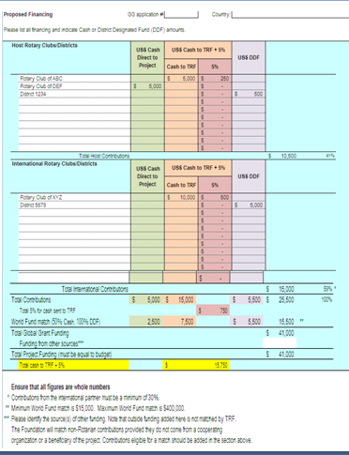
Global Grant Calculator
New excel sheet starting 1st July 2020
No World Fund matching for cash money
If cash contributions are sent to TRF to process (and receive Paul Harris Credit), the 5% would still be required.

Slide 98


Rotary Areas of Focus:
Our causes

Slide 99
Areas of Focus
Rotary is dedicated to six areas of focus to build international relationships, improve lives, and create a better world to support our peace efforts and end polio forever.
^{Basic education and literacy}
Disease prevention and treatment
^{Maternal and child health}
^{Water, sanitation and hygiene*}
Community economic development*
Peacebuilding and conflict resolution*
Notes:
Decision January 2020: [Foundation Trustee] to clarify their October 2019 decision regarding environment issues, amended decision 42 to read:
“The Trustees agree to add Environmental Issues as a new Area of Focus or add Environmental Issues to an existing Area of Focus.”

Slide 100
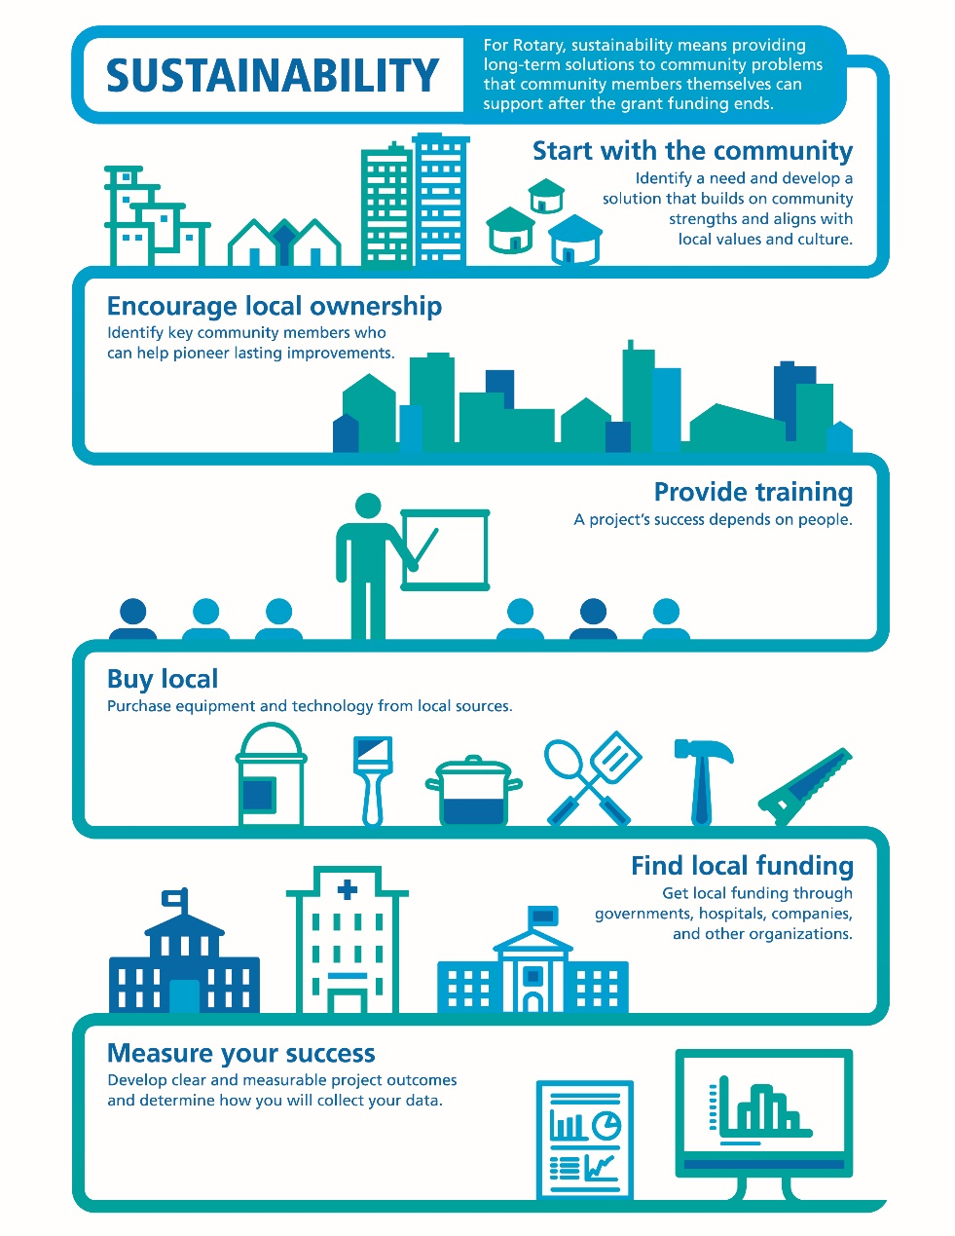
Sustainability
Six steps
1- to identify a need and develop a solution.
For Rotary, sustainability means providing long-term solutions to community needs that the beneficiaries can maintain after grant funding ends.
2- Identify key community members who can pioneer lasting improvements.
3- People knowing how to take over the project .
4- Get at least 3 bids from vendors to make sure you receive the highest quality for the best price.
5- Get local funding through governments, hospitals, companies, organizations.
6- Develop clear and measurable project outcomes and determine how you will collect your data.
Notes:
I mentioned earlier that global grants must support projects that are sustainable. Sustainability means different things to different organizations.
For Rotary, sustainability means providing long-term solutions to community needs that the beneficiaries can maintain after grant funding ends.
To help Rotary members understand what we mean by sustainability, we’ve identified six steps that can help to ensure the long-term sustainability of a project.

Slide 101
Qualification
DRFCC PDG Michel Jazzar [5 mns]

Slide 102

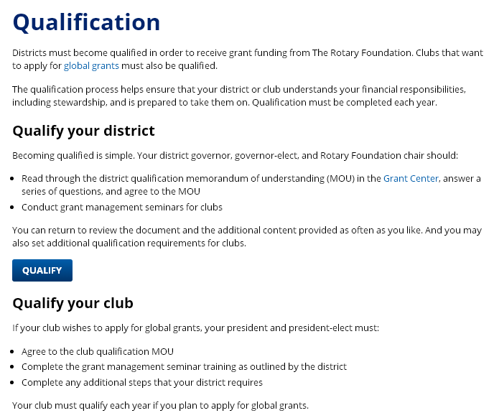

Slide 103
Qualification
Qualify the District
Qualify your Club
DG +DGE+ DRFCC
P 19-20 + PE 20-21
For TRF-MOU
Read through the district qualification memorandum of understanding (MOU) in the Grant Center,
answer a series of questions, and agree to the MOU
Conduct Grant Management Seminar_GMS for clubs.
Agree to the club qualification MOU
Complete the GMS training as outlined by the district
Complete any District additional requirements.
P 20-21 + PE 21-22
For D2452 addendum MOU

Slide 104
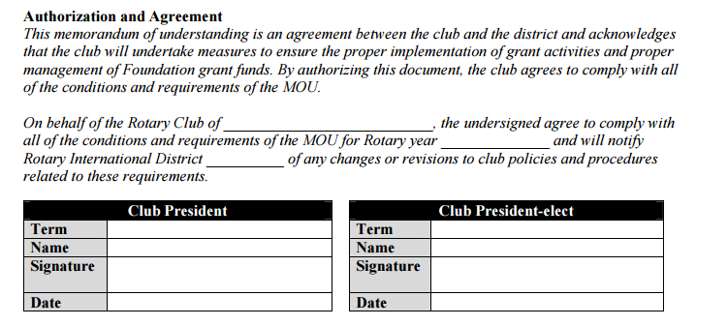
Fill and sign just after
ZM 17 June 2020
RY 2020-2021
2019-2020
2020-2021

Slide 105
D2452 additional requirements
RY 2020-2021
Attend a Grant Management Seminar_GMS. Rotary Clubs involved in grant funded projects should participate in a grant management seminar in the district. Your club can send its president 2020-21 or another member. A minimum of one representative [Board member or TRF club committee chair 2020-21] from your club must attend the GMS.
Complete the Club Memorandum of Understanding (MOU) the one of RI and the one of District 2452
Copy of Receipt of RI dues payment 1st July 2020 and/or 1st January 2021 depending on the date of completion of the submission for the Grant: Global, District and Scale.
Copy of Receipt of District 2452 dues payment dated before 31 December 2020 for the submission for the Global, District and/or Scale Grant.
Notes:
Attend a Grant Management Seminar_GMS. Rotary Clubs involved in grant funded projects should participate in a grant management seminar in the district. Your club can send its president 2020-21 or another member. A minimum of one representative [Board member or TRF club committee chair 2020-21] from your club must attend the GMS.
Complete the Club Memorandum of Understanding (MOU). The Club-MOU is an agreement between your club and district 2452 that outlines the Foundation’s minimum requirements for managing grants. Your club president [2019-20] and president-elect [2020-21] review the MOU, sign it, and submit it to D2452 officers*
Copy of Receipt of RI dues payment 1st July 2020 and/or 1st January 2021 depending on the date of completion of the submission for the Grant, Global, District and Scale.
Copy of Receipt of District 2452 dues payment dated before 31 December 2020 for the submission for the Global, District and/or Scale Grant.

Slide 106
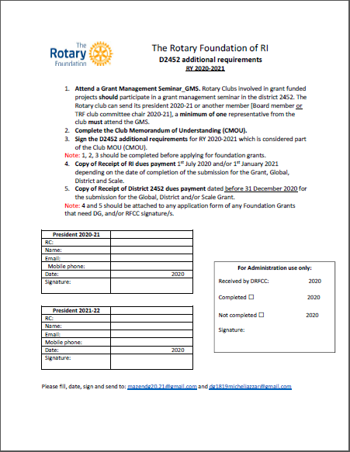
Additional requirements
Fill and sign before 31st of July 2020
RY 2020-2021

Slide 107
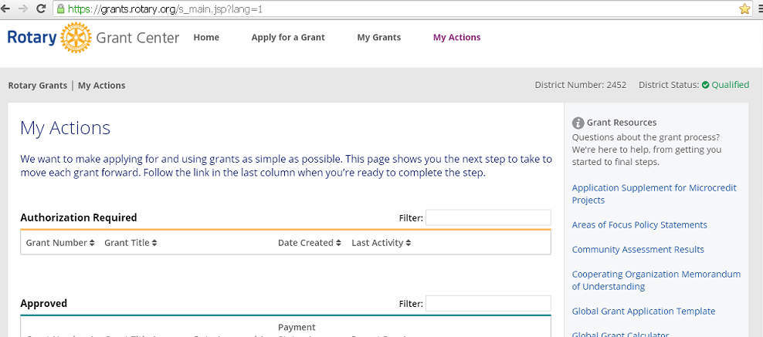
Info for RCs/Districts
Info for DG - DGE - DRFCC
Clubs: To apply
Districts : Actions

Slide 108
Foundation goals 2020-2021
by DG Mazen Al-Umran [10 mns]

Slide 109
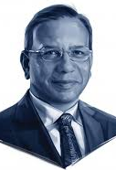

Foundation goals 2020-2021
Foundation trustee chair goals
RIPP Ravi Ravindran
DG
Goals Mazen
Al Umran

Slide 110
Foundation trustee chair goals
RIPP K. R. (Ravi) Ravindran
1st priority is, of course, to end polio.
2nd priority is to increase contributions PolioPlus and to the Annual Fund while building the Endowment Fund to $2.025 billion by 2025 and other outright gifts.
3rd priority is to improve the measurable impact of our grants.
1st priority is, of course, to end polio.
2nd priority is to increase contributions PolioPlus and to the Annual Fund while building the Endowment Fund to $2.025 billion by 2025 and other outright gifts.
3rd priority is to improve the measurable impact of our grants.
Comprehensive fundraising goal RY 2020-2021
is $410 million
150 million for polio
+
$135 million
for the Annual Fund
+
$85 million for
the Endowment Fund
+
$40 million for
other outright gifts
=
Notes:
Our comprehensive fundraising goal this year is $410 million, only a $10 million
increase from last year’s goal. Our goal may be broken down to:
• $50 million for polio, duly matched double by the Gates Foundation to bring the total to $150 million — if every club contributed just $1,500, we would meet this goal
• Then we have $135 million for the Annual Fund
• And another $85 million for the Endowment Fund in outright gifts and commitments
• And $40 million for other outright gifts adds up to a grand total of $410 million
[Let me dwell a moment on the annual giving goal of $135 million. Nearly 20 percent of our clubs do not contribute to our Foundation’s Annual Fund, nor do any of their members. Can you believe that? We can do better than that!]

Slide 111
TRF DG Goals for 2020-2021
1- Increase contributions to:
The Annual Fund: by a minimum of 50$/capita.
PolioPlus: by a minimum of 50$/capita.
Endowment Fund: by a minimum of 50$/capita.
2- Attend the Grant Management Seminar by all clubs.
3- Improve measurable impact of Global Grants and District Grants.
4- Motivate clubs to submit for the new Scale grant program

Slide 112
District 2452 - TRF Strategy
DRFFC/PDG Michel Jazzar [5mns]

Slide 113
District 2452 - TRF Strategy
DG 20-21 + DGE 21-22+
DRFCchair + DGrants chair + APF chair
DDF TOTAL AMOUNT = USD 42,750.66
PolioPlus DDF Contribution 0% DDF: USD 0,00
DGrants contribution 25% of DDF is: USD 5,093.83 ➔ COVID19 Pandemic project
Conditions: 500USD/Club =500USD /District [on 1st comes , 1sr served basis] =10 Clubs
GGrants 50%+25%DDF= total DDF for GGs is: USD 35,656.83
Conditions: If a CLUB from D.2452 contributes cash money ➔ District will contribute by 500$ for 1000$ cash club, 750$ for 1500$, 1000 for 2000$, 1500 for 3000$ cash as a maximum [1st comes, 1st served basis].
Deadline to benefit from DDF is 2 months starting approval DG+DRFCC, time needed for the club to submit the project to TRF, get a number and approval from TRF Grant coordinator staff [Daniel Weyl]. If the RC didn’t get approval from TRF on the project by the 60th day, the district contribution will be cancelled for the benefit of another club.
Each club can benefit of only one DDF contribution/all RC’s Projects/RY 20-21.

Slide 114
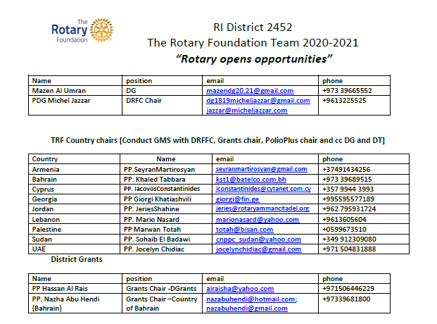
TRF Team 2020-2021_a

Slide 115
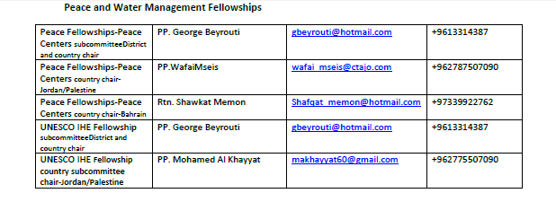
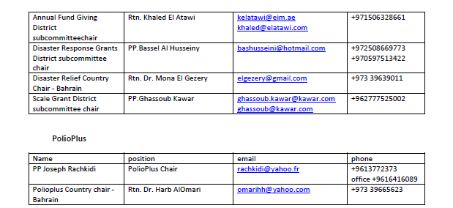
TRF Team 2020-2021_b

Slide 116

Updates on Grants
G.M.S

Slide 117
PP Jiries Shahine [5 mns]
G.M.S

Slide 118
WF matching, new regulations
Trustees of TRF have decided that World Fund resources will be used to match only District Designated Fund (DDF) contributions. This match will remain at 100 percent.
The match on cash contributions to grants will be eliminated, effective 1 July 2020. This match will remain at 0 percent.
Global grant applications that have been submitted but not yet approved on 1 July will still receive the World Fund match for cash contributions.
By supporting the Annual Fund, members can ensure a steady supply of both DDF and World Fund resources for the GG projects that change people's lives.

Slide 119
WF matching ➔ new regulations
DDF contribution
=
100% by WF
Cash/RC contribution
=
0% by WF

Slide 120
Grant management courses available in Learning Center
Maximum global grant raised to $400,000
Community assessments is required for global grants.
New Peace Center for Certificate in Uganda
Certificate’s duration is now for 1 year.
Environment is included in the 6AOF* or is it a new AOF**?
*The Trustees agree to add Environmental Issues to existing AOF FOR 2019-2020
**The Trustees may agree to add Environment Issues as a new AOF FOR 2020-2021 ? Decisions at the last Trustees meeting, then approval of the RI board meeting in June 2020
Notes:
Here are a few grant-related updates:
Grant management resources are now available in Rotary’s Learning Center. Find courses on making your project sustainable, conducting community assessments, planning effective projects, managing grant finances, qualifying your club for Rotary grants, reporting on grants, and much more. Your district could choose to offer the online courses as a way to get qualified, or you can choose a mixed approach, having attendees take the online courses first and then attend a shorter in-person training to discuss district requirements, questions, etc.
The Trustees of The Rotary Foundation increased the maximum global grant award by doubling the maximum amount of World Fund money available for a global grant to $400,000. The Trustees also raised the threshold at which they review a global grant application. They will now review an application if the grant would use more than $200,000 in World Fund money.
Remember that any club or district that applies for a global grant to support a humanitarian project or a vocational training team must conduct a community assessment first and design the project based on the results of the assessment. Applicants need to include the results in their grant application.

Slide 121
UPDATES – AREAS OF FOCUS
Updates provide:
  Greater clarity
  Additional project types
  Activities focused on the environment
Names changed slightly
Notes:
As I mentioned earlier, the Trustees recently approved changes to the areas of focus to offer greater clarity, provide additional project types, and include activities that focus on the environment.
We’ve kept the existing six areas but adjusted some names slightly to better reflect the types of projects that Rotary members are carrying out.

Slide 122
UPDATES – AREAS OF FOCUS
Peacebuilding and conflict prevention*
Disease prevention and treatment
Water, sanitation, and hygiene*
Maternal and child health
Basic education and literacy
Community economic development*
*Names slightly changed
The Trustees agree to add Environmental Issues to existing AOF FOR 2019-2020
The Trustees may agree to add Environment Issues as a new AOF FOR 2020-2021 ? Decisions at the last Trustees meeting, then approval of the RI board meeting in June 2020
Notes:
The areas of focus are now:
Peacebuilding and conflict prevention
Disease prevention and treatment
Water, sanitation, and hygiene
Maternal and child health
Basic education and literacy
Community economic development
The names that were updated are noted with an asterisk.

Slide 123
Updates - data privacy
Reminders to Steps 7, 8, and 10 of the global grant application about the importance of protecting others' personal data by not including sensitive information, such as government ID numbers, religion, race, or health information…
If you take images or videos of any identifiable person, you need to get their consent before you use or publish the images or videos.

Slide 124
RESOURCES FOR FINDING PARTNERS
By PP Jocelyn Shidiac
TRF Country chair – UAE [5 mns]

Slide 125

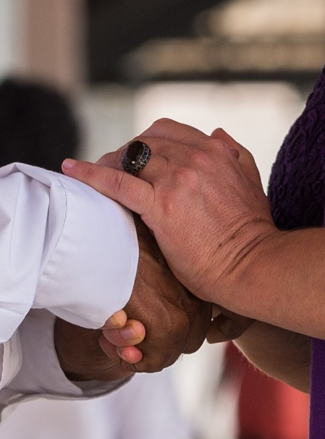
RESOURCES FOR FINDING PARTNERS
platform that allows you to request partners, materials, or international support and contributions
Rotary Ideas
Rotary discussion groups
Rotarian Action Groups
Intercountry committees
Project Fairs
Rotary Fellowships
forum for clubs to exchange project ideas and request assistance
experts in a particular field
networks of Rotary clubs or districts in two or more countries working together on service projects
regional events that Rotary districts host to encourage international friendship and collaboration
social groups that share an interest in a hobby, recreational activity or profession
Notes:
We also have lots of resources to help you find a project partner:
Rotary Ideas, a platform that allows you to request partners, materials, or international support and contributions
Rotary discussion groups, a forum for clubs to exchange project ideas and request assistance
Rotarian Action Groups, members and others who are experts in a particular field and who help club and district projects
Intercountry committees, networks of Rotary clubs or districts in two or more countries working together on service projects, sponsoring new clubs, or other activities
Project Fairs, regional events that Rotary districts host to encourage international friendship and collaboration
Rotary Fellowships, independent, social groups that share an interest in a hobby, recreational activity or profession

Slide 126



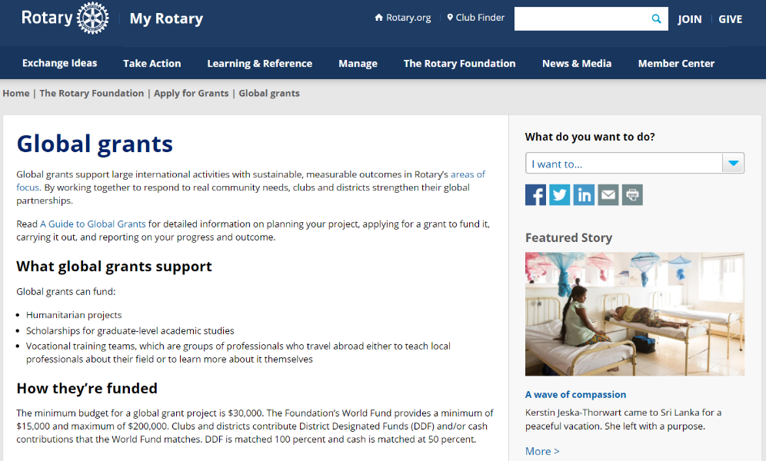
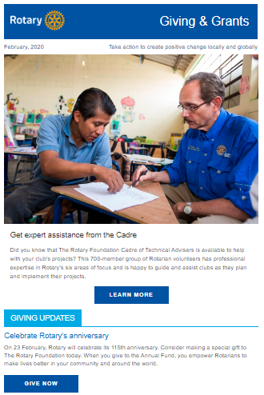

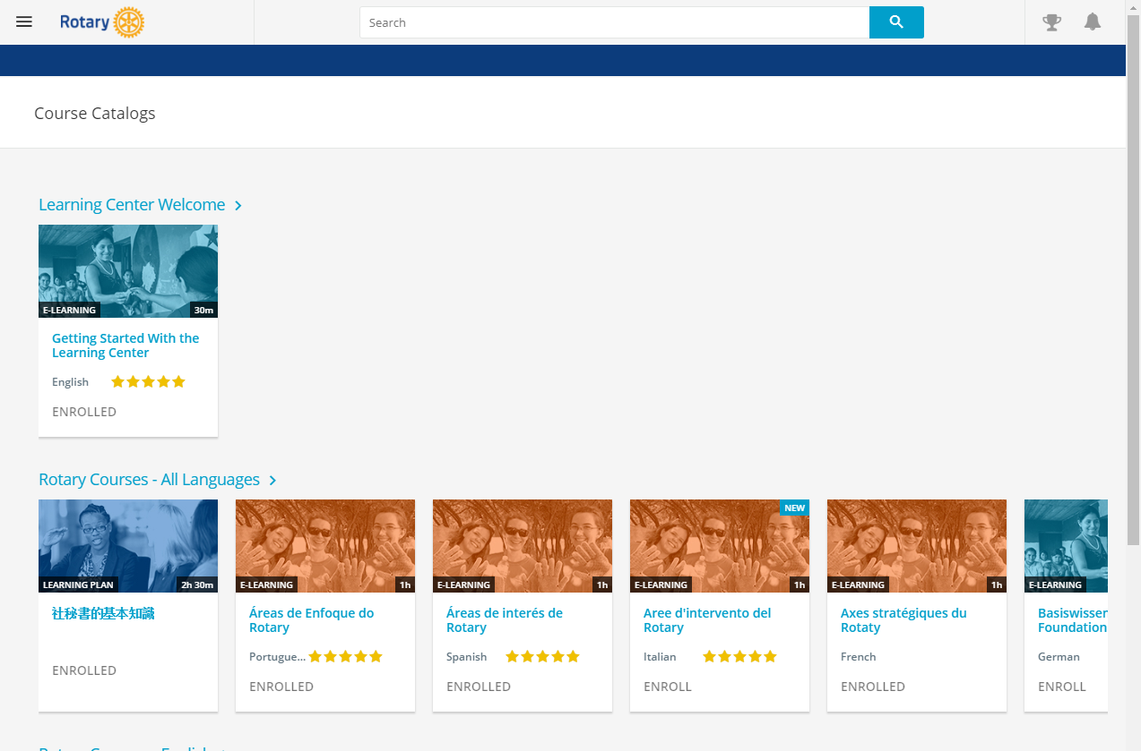
RESOURCES
Notes:
We have a number of resources available to help you take full advantage of grant opportunities.
First and foremost, I encourage you to read A Guide to Global Grants. This helpful manual includes everything you need to know to get started with global grants.
Rotary’s website has a wealth of general and detailed information about grants.
The newly refreshed learning center offers training resources on a wide variety of topics, including, as I mentioned earlier, information to help you apply for Foundation grants.
And, we’ve recently updated Community Assessment Tools, which is an invaluable resource for clubs and districts who are conducting a community assessment.

Slide 127
What's New in the Learning Center
Club Officers Basics courses – These courses have been updated to reflect changes made during the 2019 Council on Legislation.
Club Administration Committee Basics
Club Membership Committee Basics
Club Public Image Committee Basics
Club Rotary Foundation Committee Basics
Club Secretary Basics
Club Service Projects Committee Basics
Club Treasurer Basics

Slide 128
General resources
The Grant Management Seminar in Rotary's Learning Center includes courses
The Rotary Foundation Reference Guide provides a brief overview of Rotary Foundation programs and services.
A Guide to Global Grants applying for a global grant
The updated Project Fairs page lists information
Notes:
The Grant Management Seminar in Rotary's Learning Center includes courses on making your project sustainable, conducting a community assessment, planning an effective project, managing grant finances, qualifying your club for Rotary grants, reporting on grants, and more.
The Rotary Foundation Reference Guide provides a brief overview of Rotary Foundation programs and services.
A Guide to Global Grants is a valuable training resource for members who are interested in applying for a global grant or developing more effective and sustainable service projects.
The updated Project Fairs page lists information about these regional events that Rotary districts host to encourage international friendship and collaboration.

Slide 129
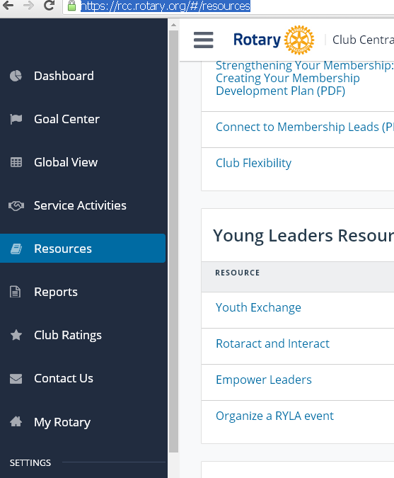
Where to find resources on RI website?
www.rotary.org then click on: MyRotary [username and password] and Go to ➔ Rotary Club Central https://rcc.rotary.org/#/resources ➔ Column ➔ Resources.

Slide 130
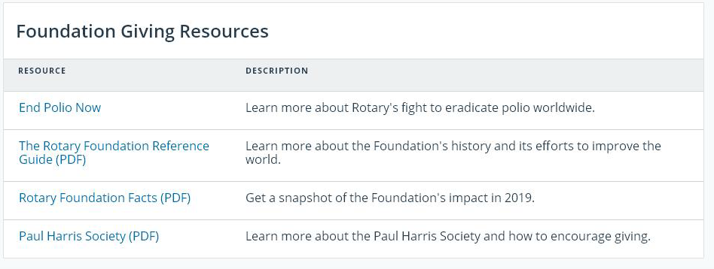
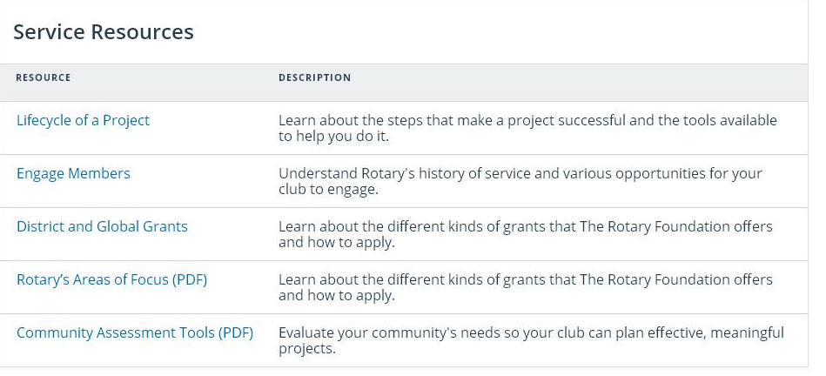

Slide 131
Useful web links
https://my.rotary.org/en/take-action
https://my.rotary.org/en/take-action/apply-grants
https://my.rotary.org/en/take-action/apply-grants/programs-scale-grants
https://my.rotary.org/en/take-action/apply-grants/grant-travel
https://my.rotary.org/en/take-action/apply-grants/rotary-disaster-response-grants
https://my.rotary.org/en/take-action/apply-grants/qualification
https://visitrotary.com/club-resources/
https://opportunitydesk.org/2019/12/11/rotary-scholarships-for-water-and-sanitation-professionals-2020-2022/
https://learn.rotary.org/members/learn/lp/101/Grant%2520Management%2520Seminar

Slide 132

RFCC PDG Michel Jazzar

Slide 133
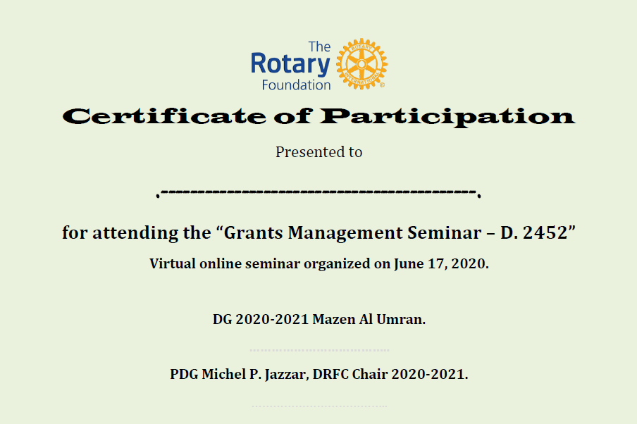

Slide 134








Connect for more opportunities
jazzar@micheljazzar.com
dg1819micheljazzar@gmail.com
/michel.jazzar
michel jazzar
@jazzar
mpjjazzar
@ /rirunescwa
jazzar1951
http://riescwa.hautetfort.com
http://www.authorstream.com/jazzar

Slide 135
G.M.S 2020-2021 ندوة إدارة المنح
Thank you for Contributors
DG Mazen Al-Umran [Strategy and Disaster funds]
PP Ghassoub Kawar [Scale Grants]
PP Jocelyn Shidiac [Resources]
PP Jiries Shahine [Global Grants]
PP Iacovos Constantinides [Foundation Grants]
PP Georges Beyrouti [Peace & Water fellowships]
PP Joseph Rachkidi [PolioPlus]
Rot. Khaled El Atawi [Annual Fund Programs]
PP Hassan Al Rais [District Grants]
PP Khaled Tabbarah [TRF mission and programs]
DT/PDG Ignace Mouawad [Apply for grants]
DRFCC/PDG Michel Jazzar [Hints-Qualification]

Slide 136
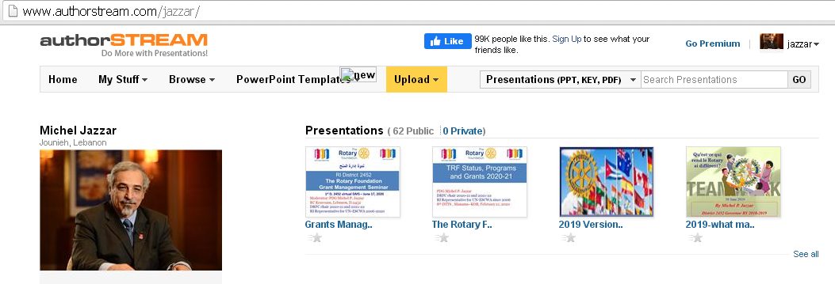
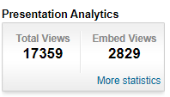
http://www.authorstream.com/jazzar

Slide 137

Questions?
Thank you!

Slide 138

GMS 2020
D. 2452

